Slide 1






Associative learning changes multivariate neural signatures of visual working memory
William XQ Ngiam
Awh / Vogel Lab
University of Chicago
Will Epstein
Henry Jones
Darius Suplica
William Thyer
Edward Awh

Slide 2
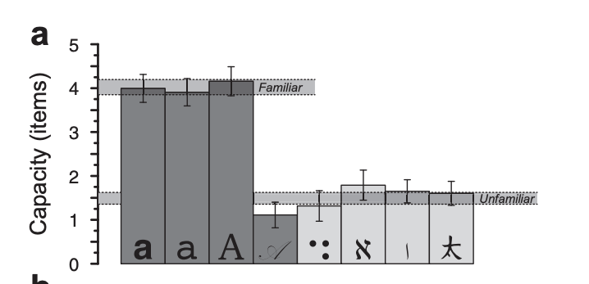
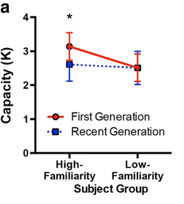

Working memory is aided by long-term memory
A multivariate neural signature tracking pointers
A hallmark of our visual working memory system is its sharp capacity limit
But this capacity limit can be overcome with familiarity:
Ngiam et al. (2019) JEP:G
Xie and Zhang (2017) M&C

Slide 3
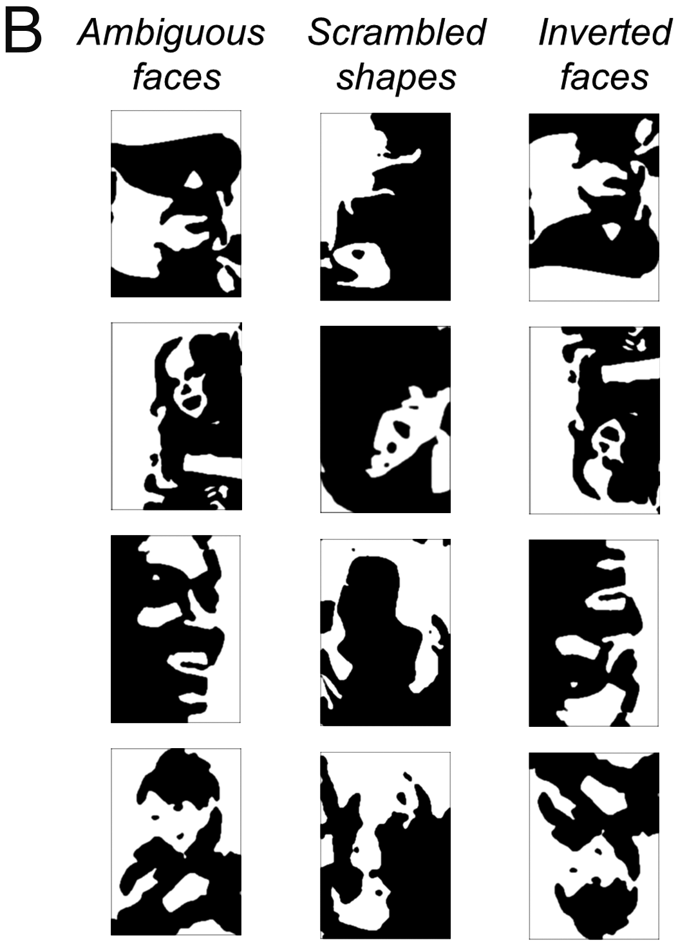
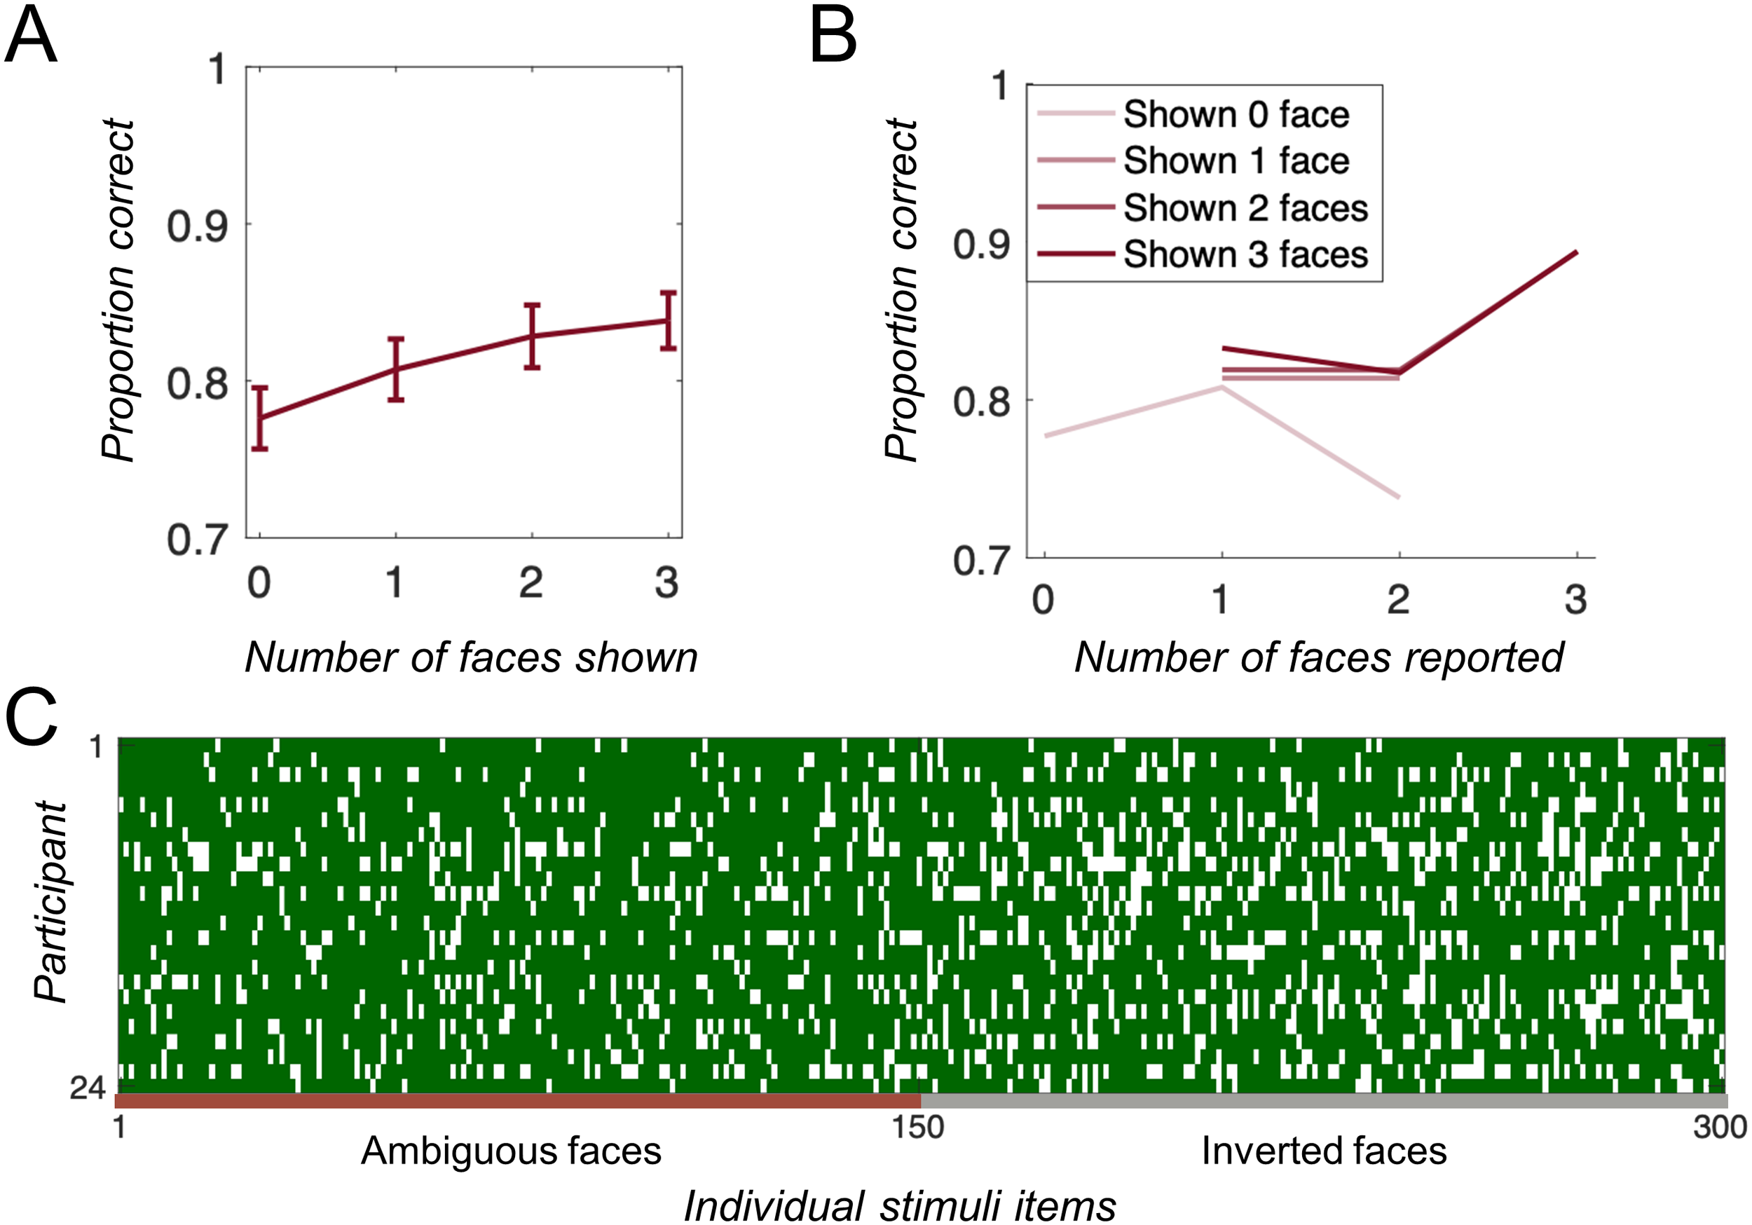
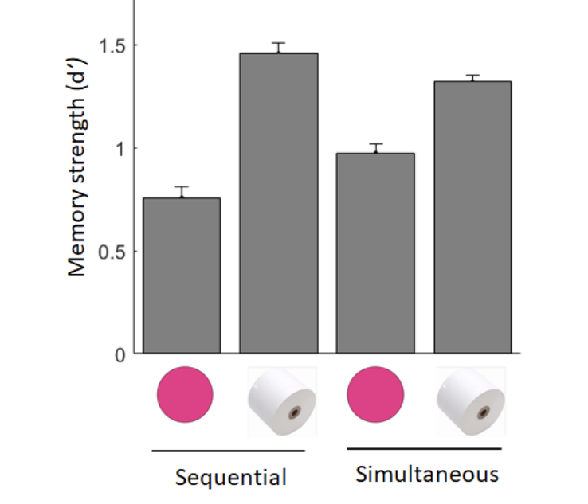
Meaningfulness // real-world objects:
Asp et al. (2021) JoCN
Brady and Störmer (2022) JEP:LMC

Slide 4
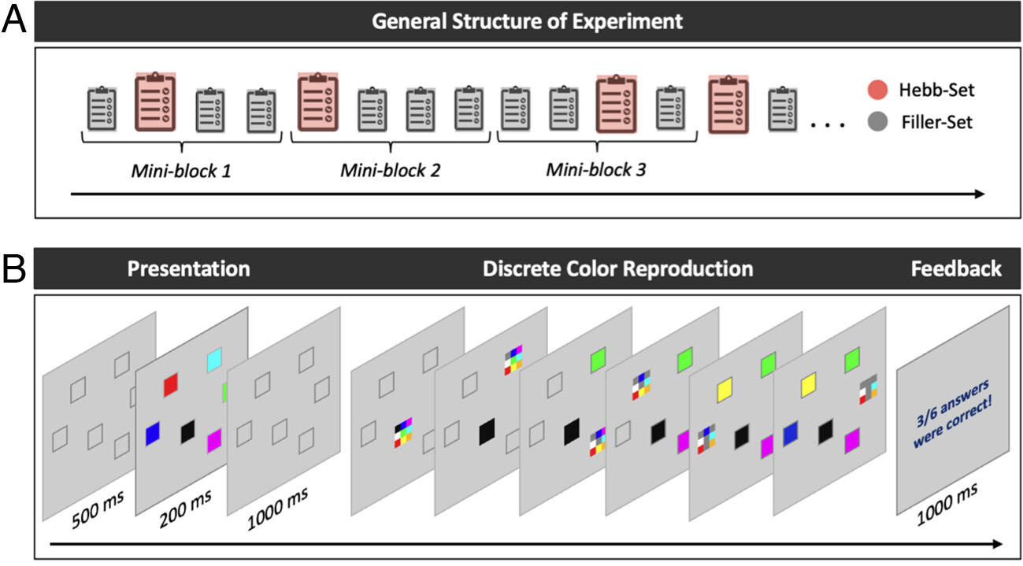

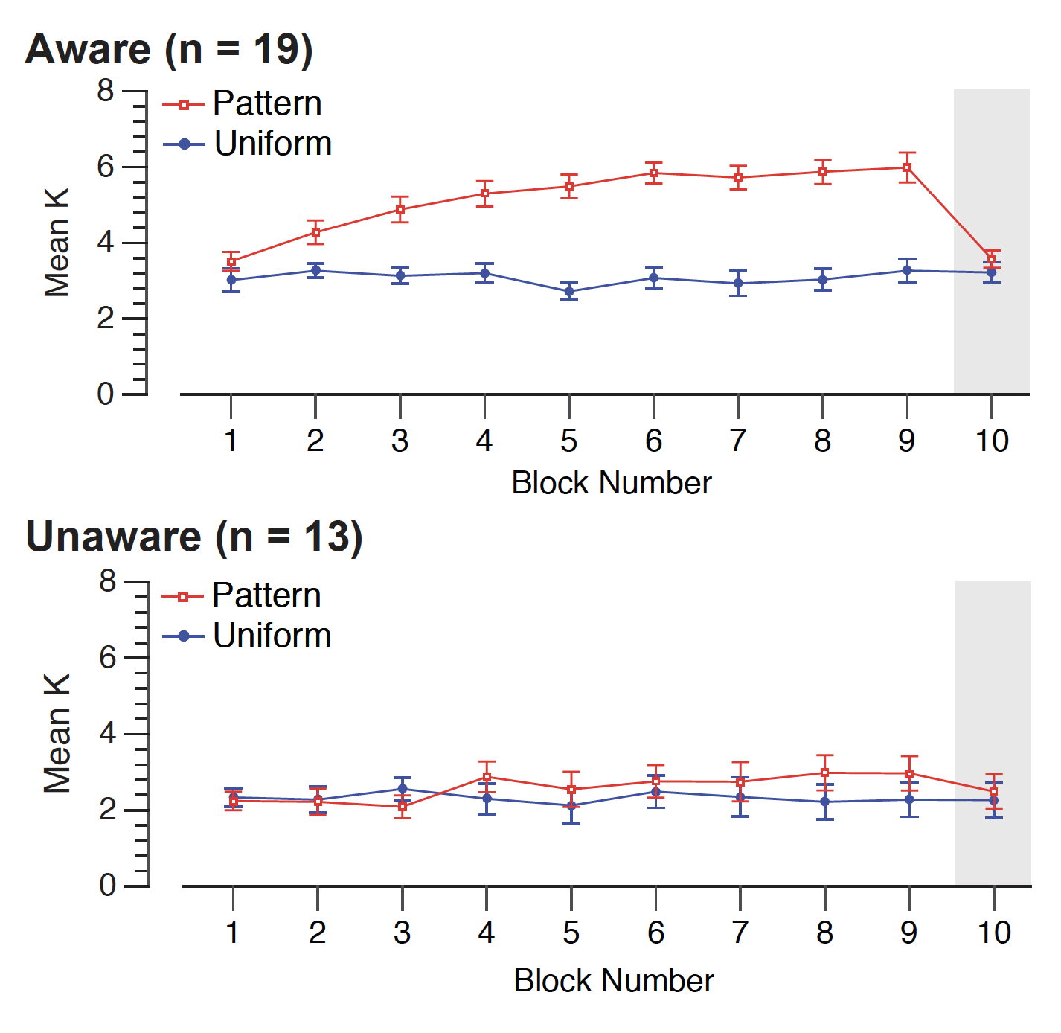
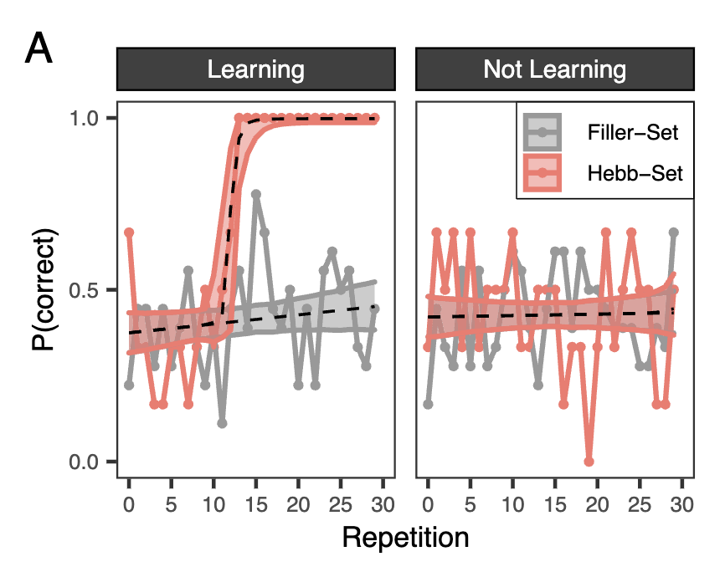
Repetition learning // associative learning:
Musfeld et al. (2023) PNAS
Ngiam et al. (2019) JEP:G

Slide 5
How is working memory performance improved?
Working memory load may be expanded for familiar // meaningful // learned stimuli
Additional resources are recruited allowing a greater number of items to be held within working memory
Working memory load is reduced via chunking
Load is reduced by requiring fewer “chunks” to be held in working memory
Recall is improved by relying on recruitment of long-term memory

Slide 6


Pointers in working memory
Pylyshyn (2009) proposed the visual system has an indexing mechanism that keeps track of an individual object through its changes
This index is abstracted from the contents of the object
We propose that items in working memory are assigned to a content-independent pointer
Location
content-independent
pointer
Colour
Shape
Notes:
x

Slide 7
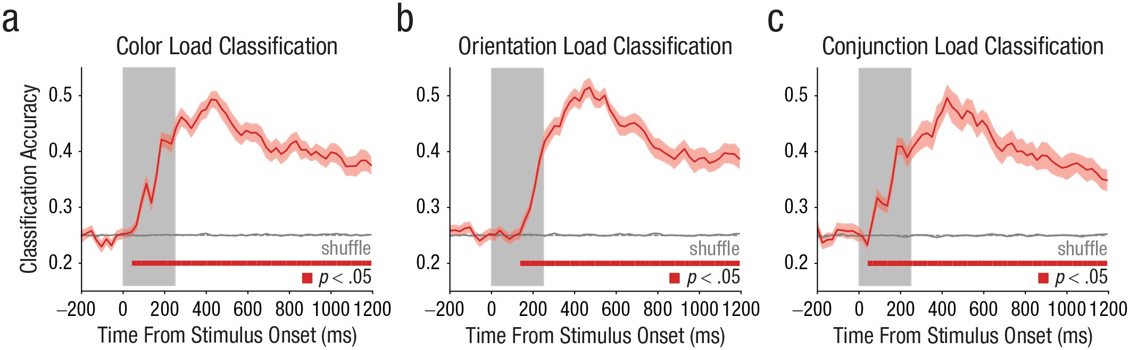
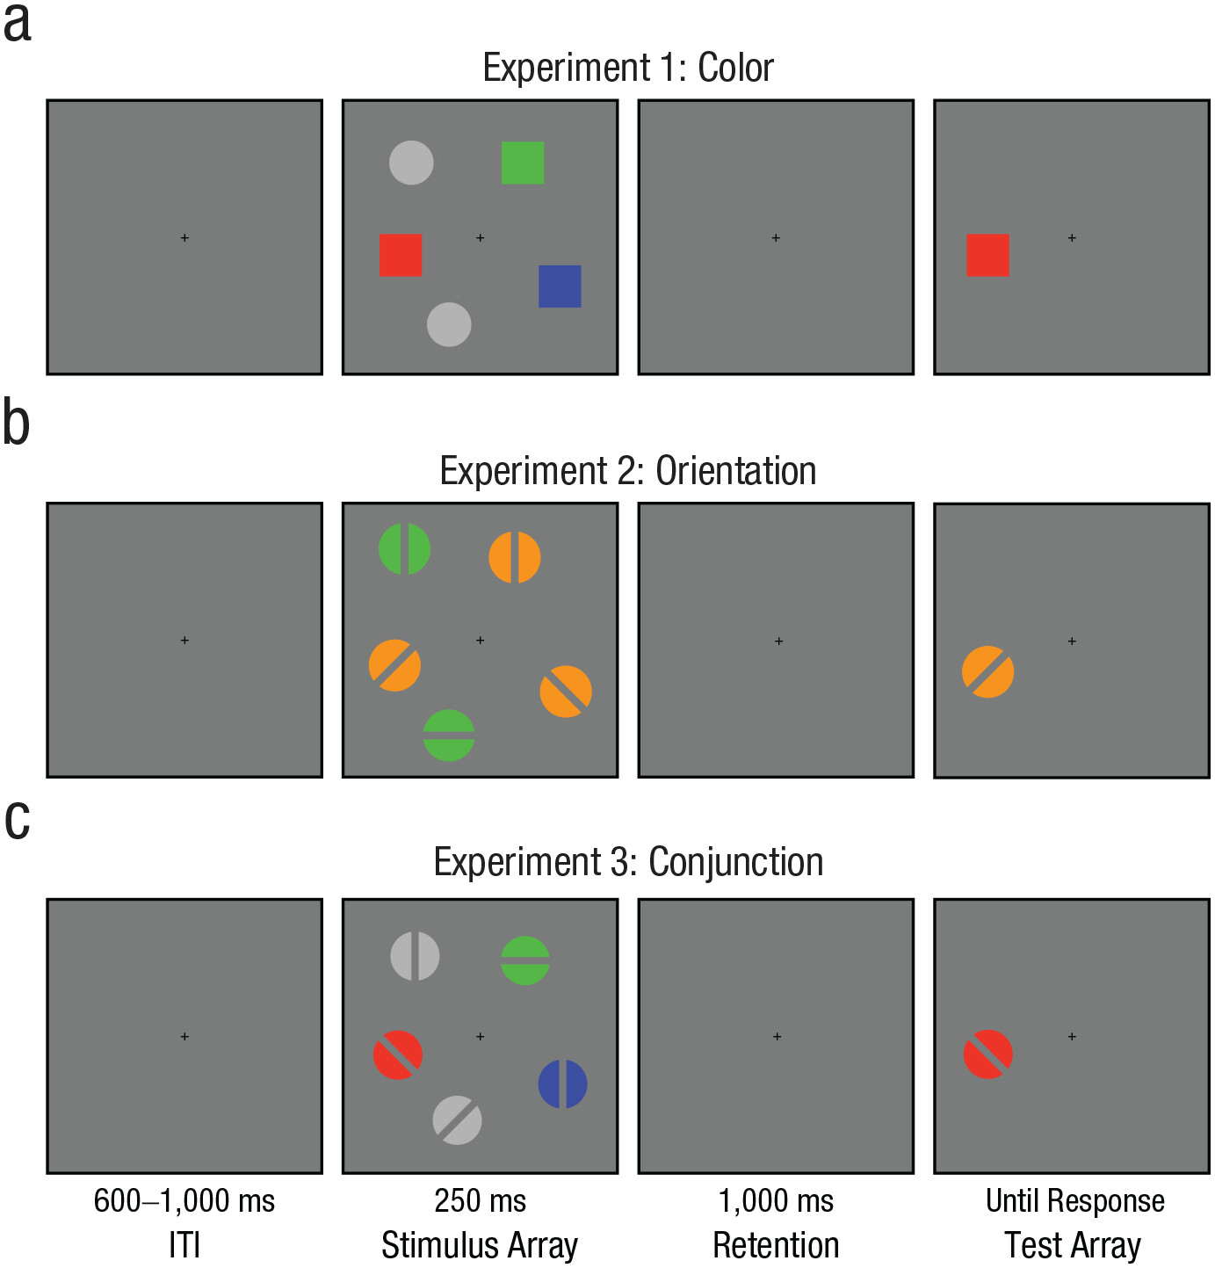

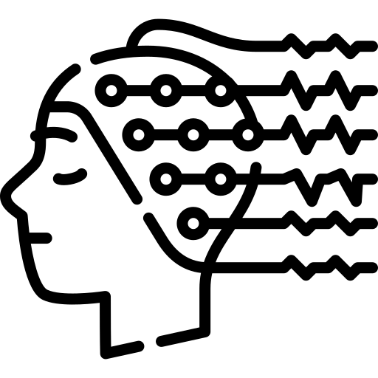
Multivariate neural signature of WM pointers
Train and test
Train and test
Thyer et al. (2022) Psychological Science

Slide 8
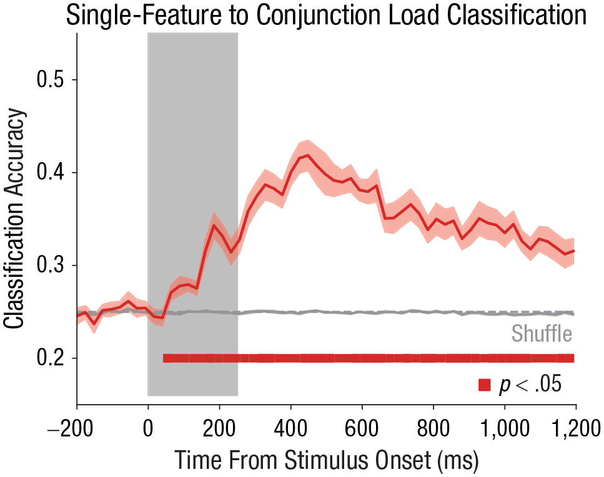
Multivariate neural signature of WM pointers
Train
Test
Thyer et al. (2022) Psychological Science

Slide 9
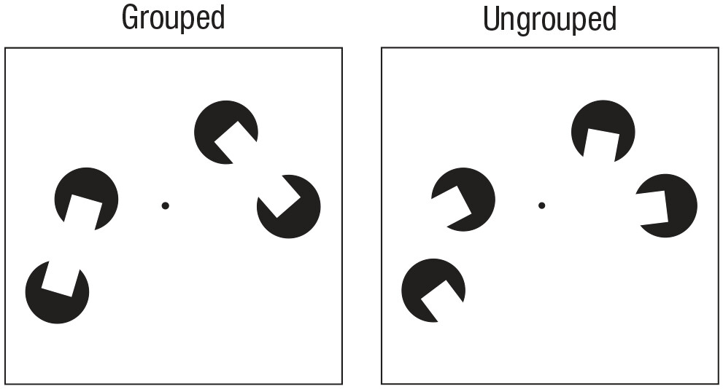
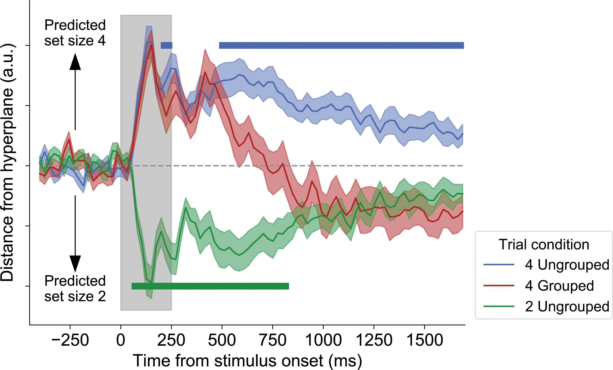
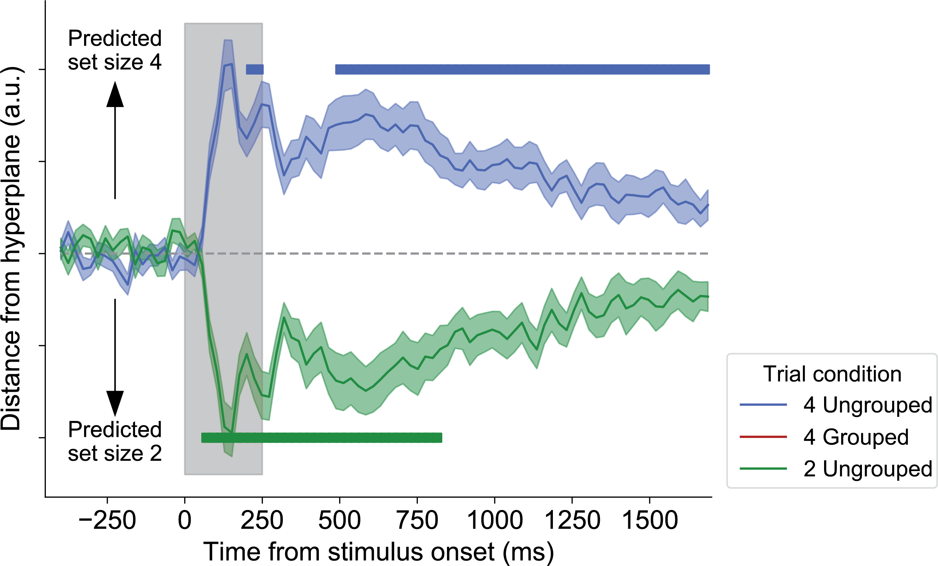
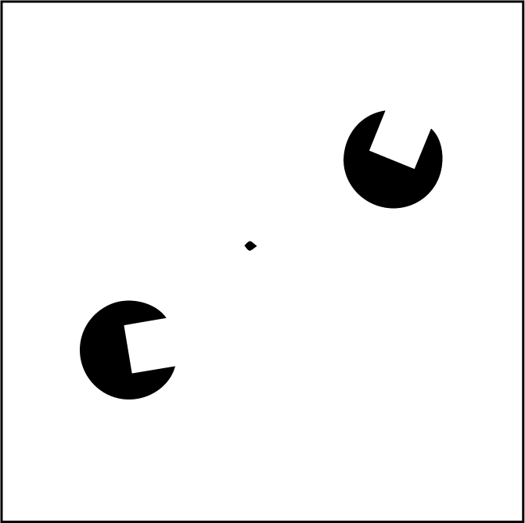
Multivariate neural signature of WM pointers
4 Ungrouped
4 Grouped
2 Ungrouped
Thyer et al. (2022) Psychological Science

Slide 10
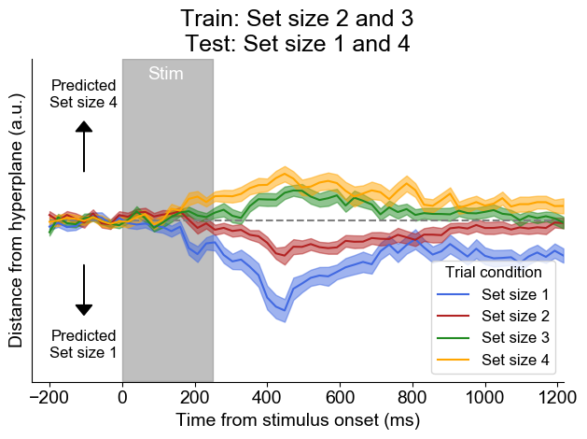
Different working memory loads on the hyperplane
Predicted
Set size 3
4 is above 3
Working memory load signal
Predicted
Set size 2
1 is below 2

Slide 11
Multivariate neural signature of WM pointers
The multivariate load signal for pointers is dissociated from spatial attention Jones et al. (accepted), Psychological Science
The load signal generalizes from color to motion coherence of random dot kinematograms Henry’s VSS talk this year
Henry Jones
The multivariate load signal is shared for audio and visual stimuli in prep
Darius Suplica
How do working memory pointers change with associative learning?

Slide 12
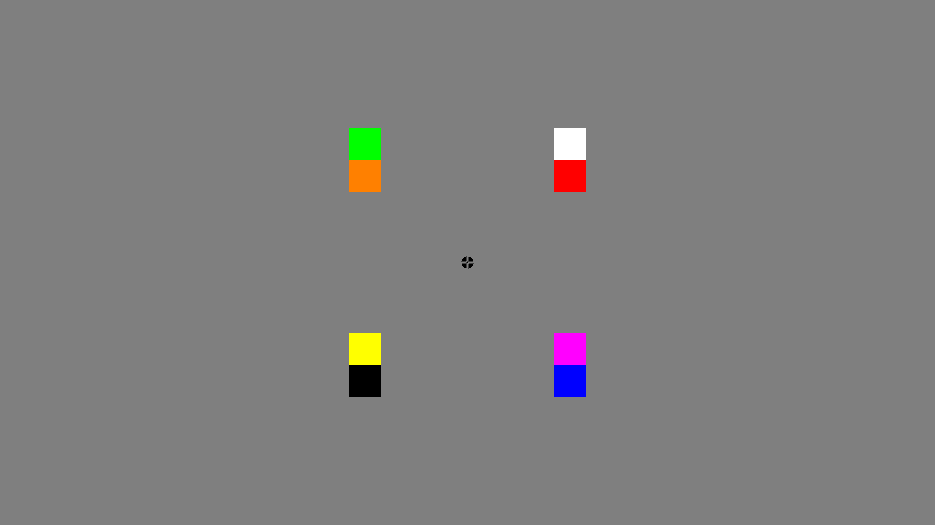
Experiment 1: Training
Subjects completed 600 trials to learn four color pairs:

Slide 13
Experiment 1: Training

Slide 14
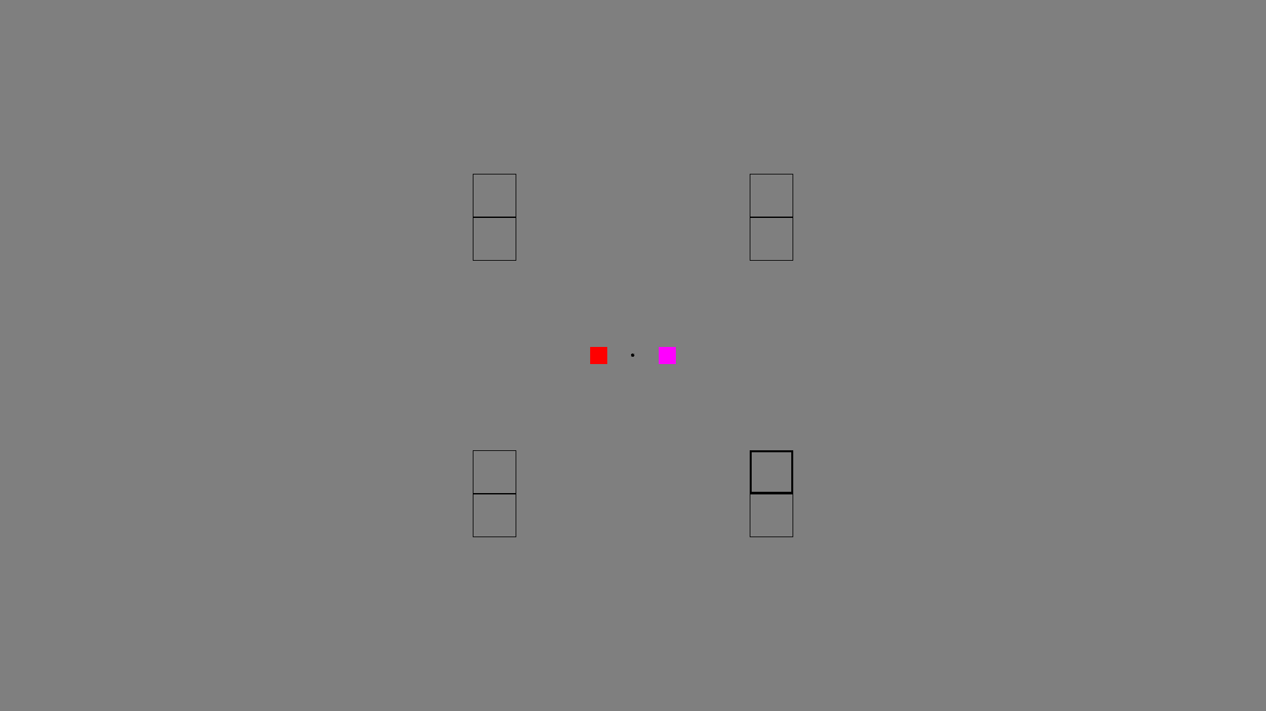
Experiment 1: Training
Two alternative-forced choice – which color was in the bolded location?

Slide 15
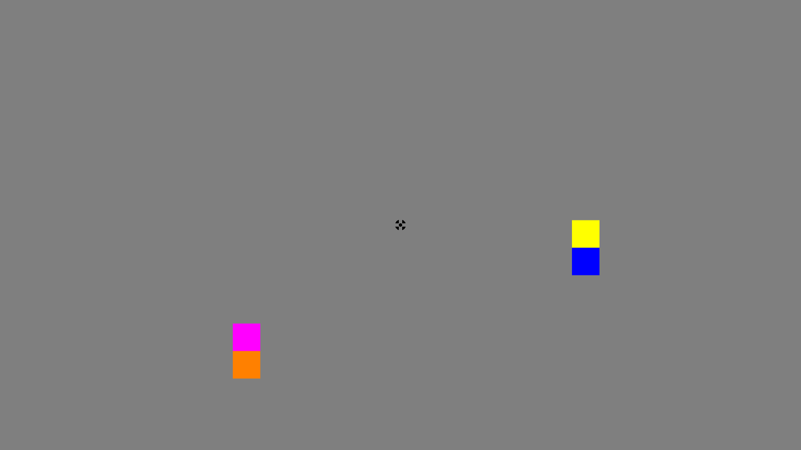
Experiment 1: Pre-training and post-training
Before training – 4 random colors
After training – 4 paired colors (two learned pairs)

Slide 16
Experiment 1: Pre-training and post-training

Slide 17
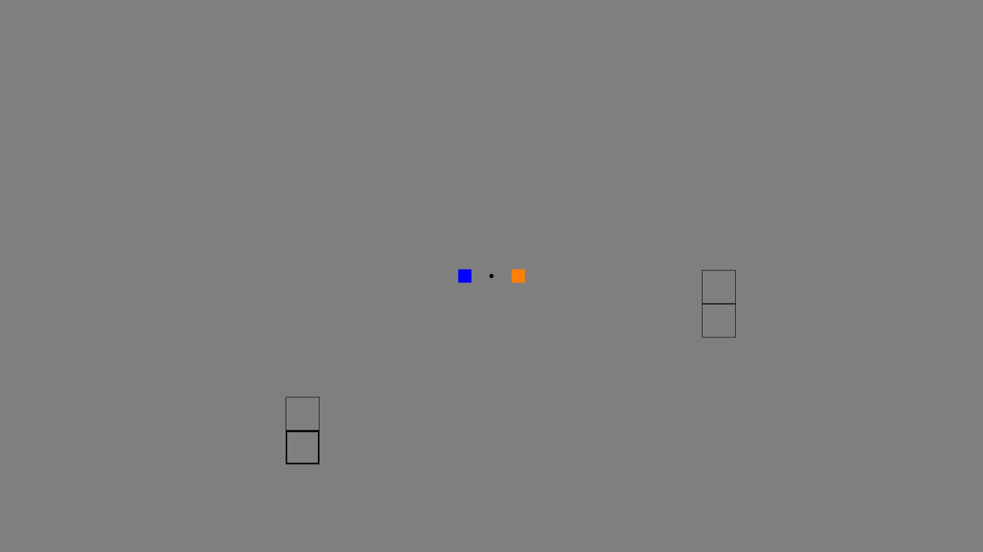
Experiment 1: Pre-training and post-training

Slide 18
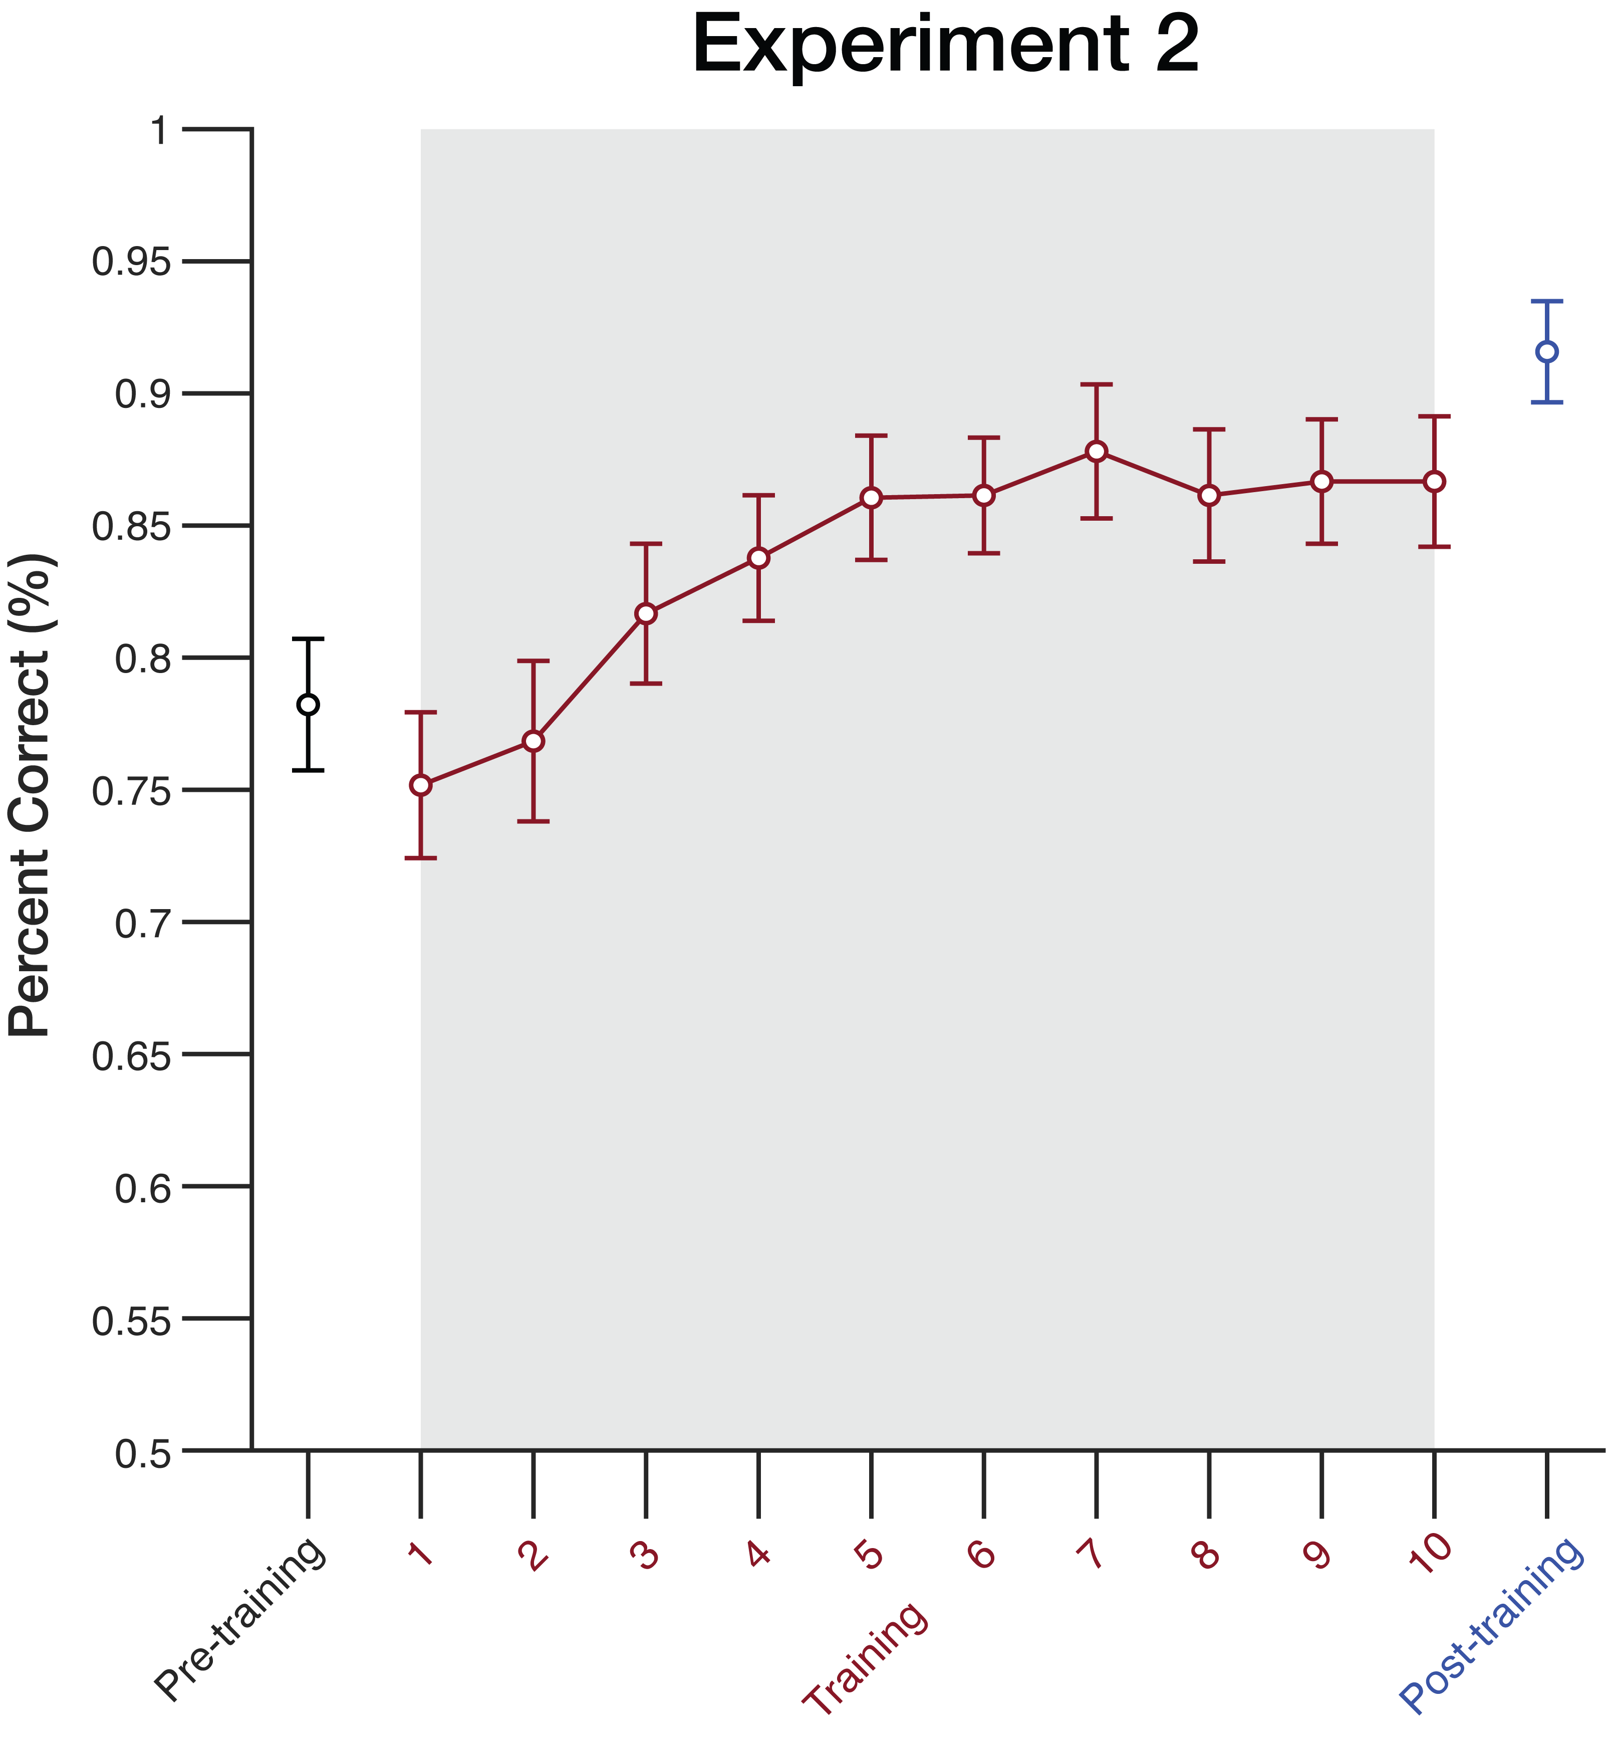
E1: training session – aggregate performance
Four random
Four paired
Eight paired

Slide 19
E1: training session – average performance
Four random
Four paired
Four learned color pairs

Slide 20
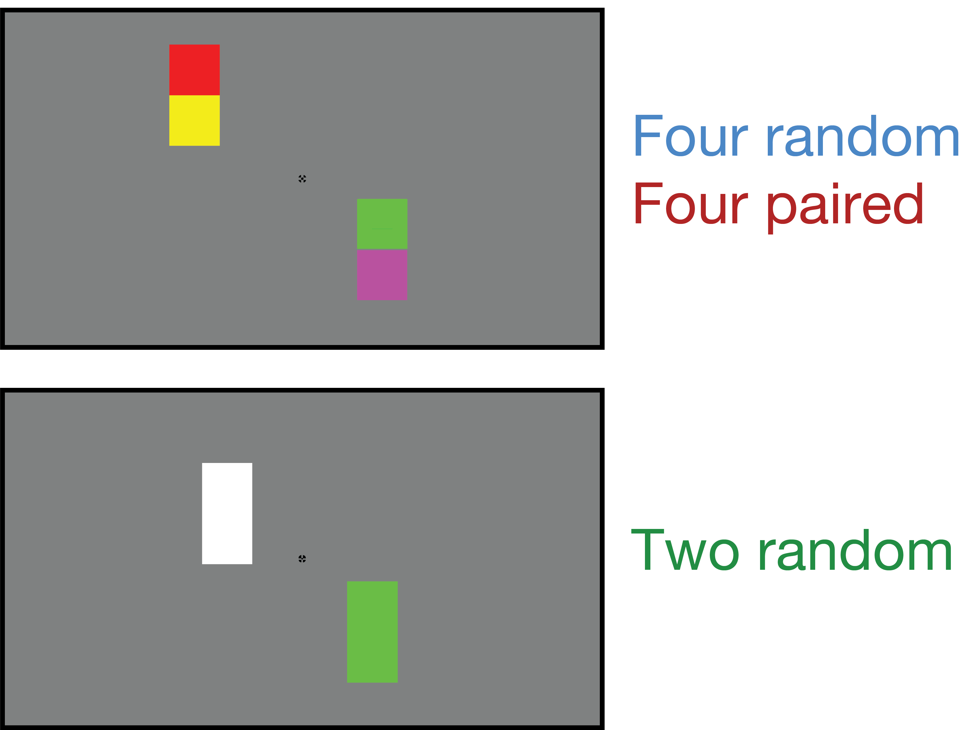
Experiment 1: EEG session
Perceptually
equivalent

Slide 21
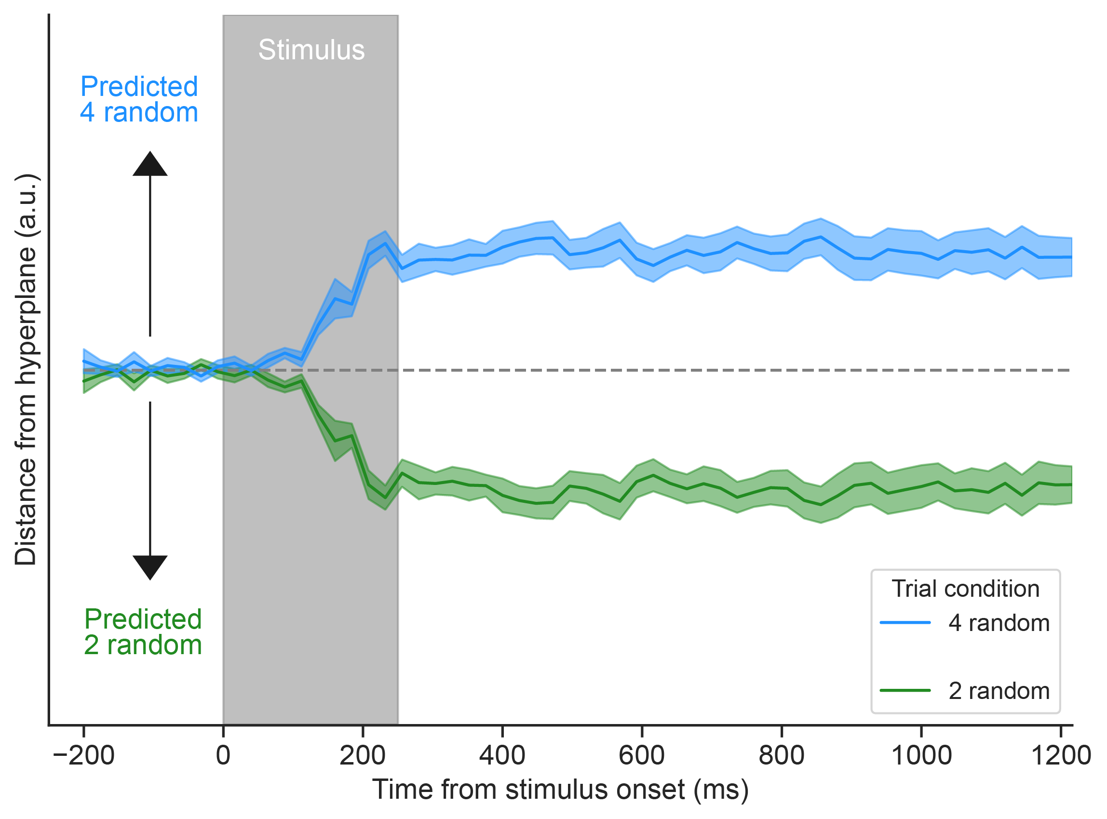
Train 2 random versus 4 random

Slide 22
Train 2 random versus 4 random, where is 4 paired?
An increase in
number of
items stored

Slide 23
Train 2 random versus 4 random, where is 4 paired?
Reduction in
items stored

Slide 24
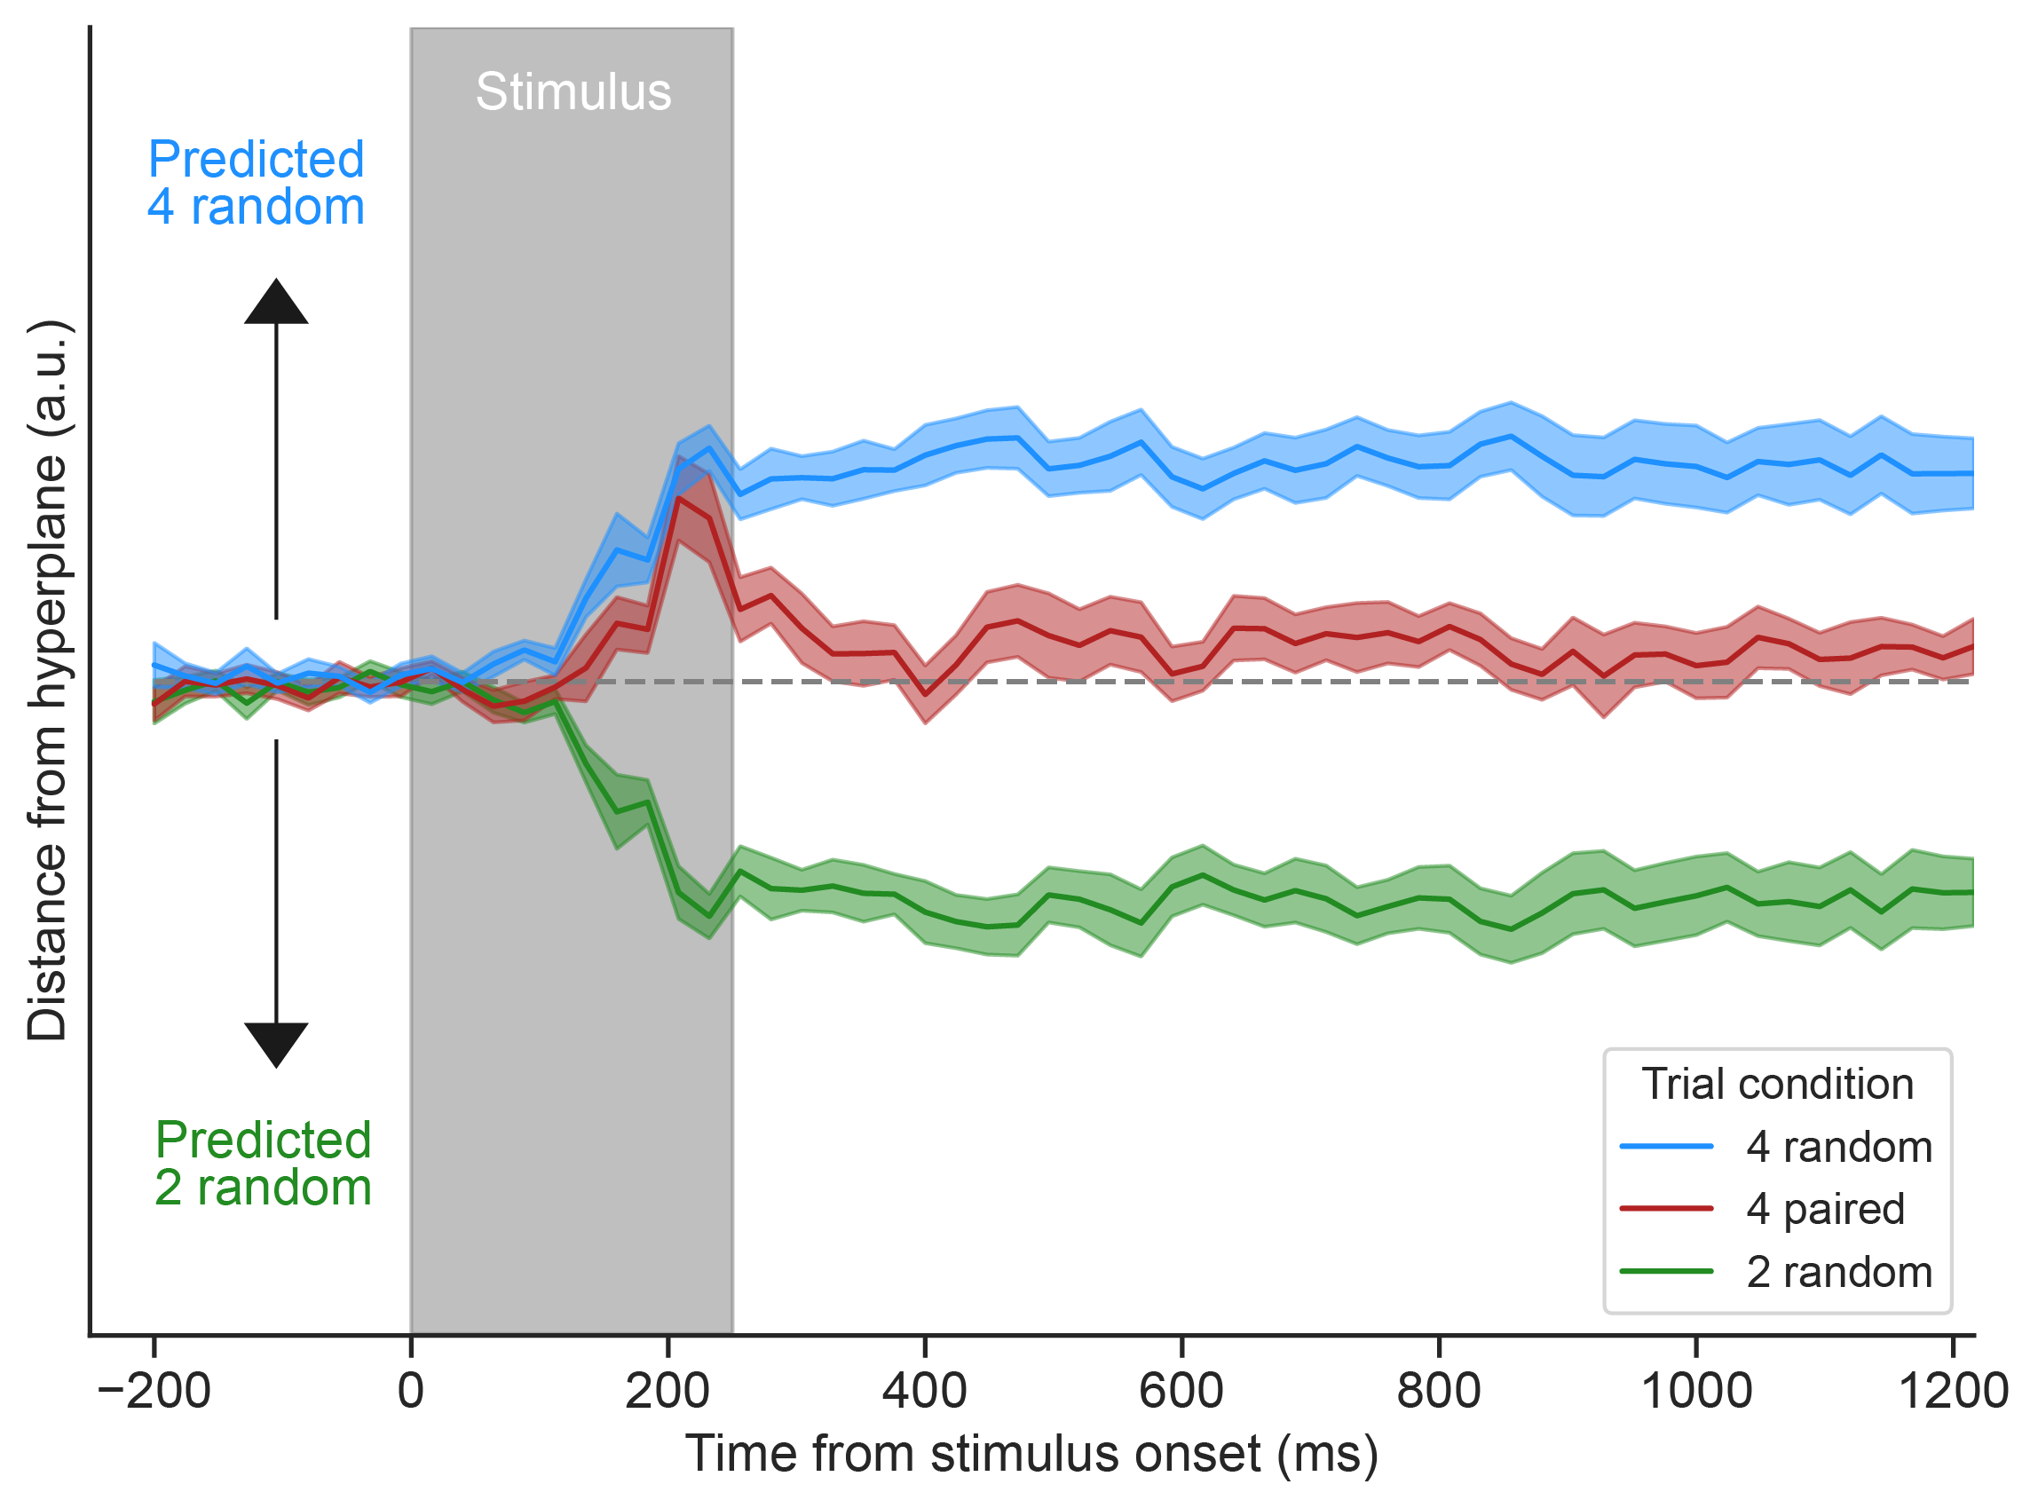
Train 2 random versus 4 random, test 4 paired
Some reduction
In load

Slide 25
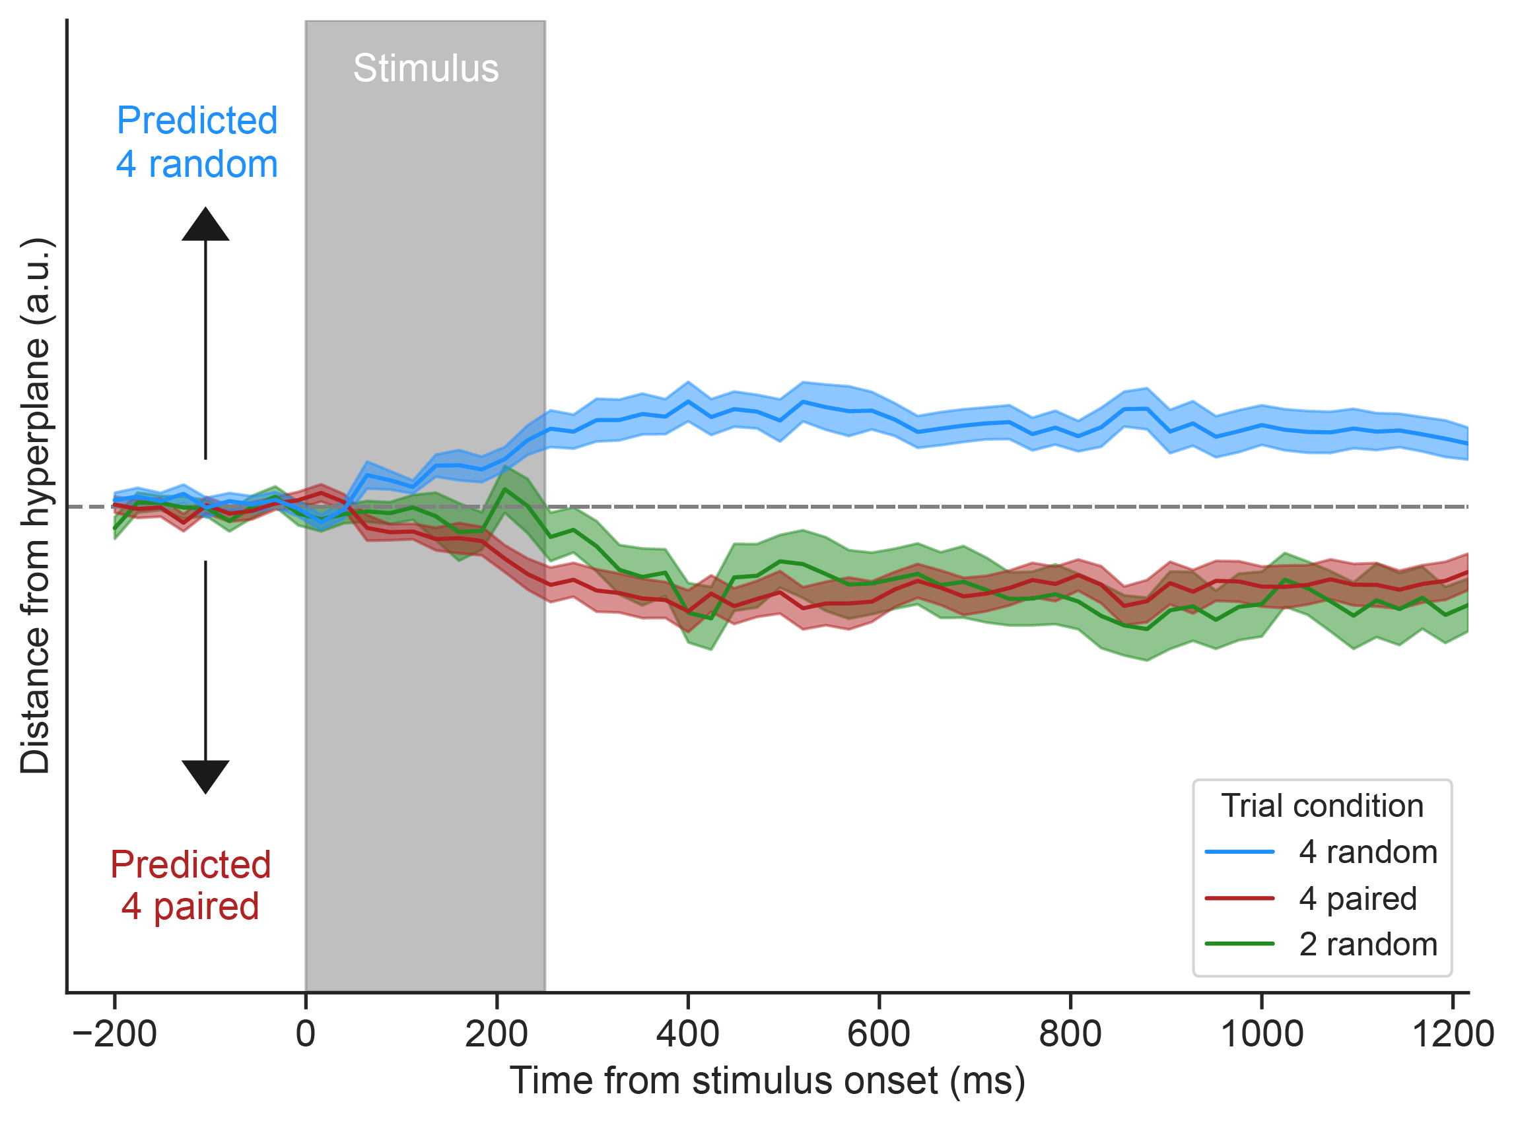
Train 4 random versus 4 paired, test 2 random
Perceptually
equivalent

Slide 26
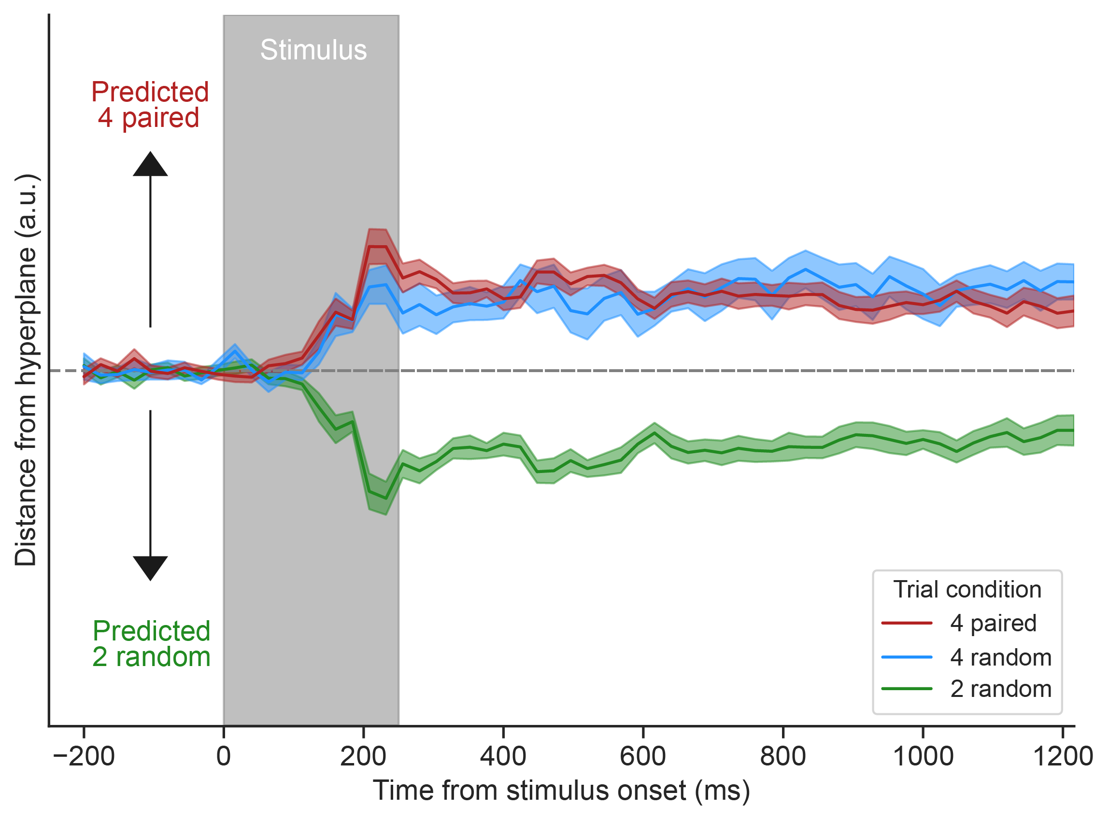
Train 2 random versus 4 paired, test 4 random

Slide 27
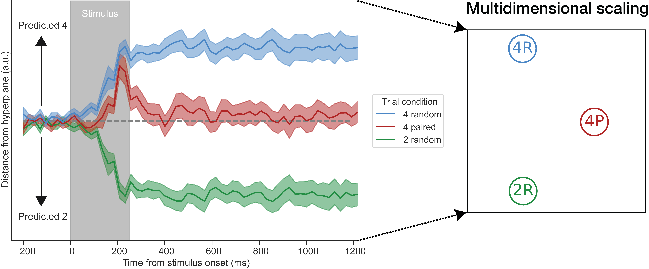
Multidimensional scaling

Slide 28
Multidimensional scaling

Slide 29
Multidimensional scaling

Slide 30
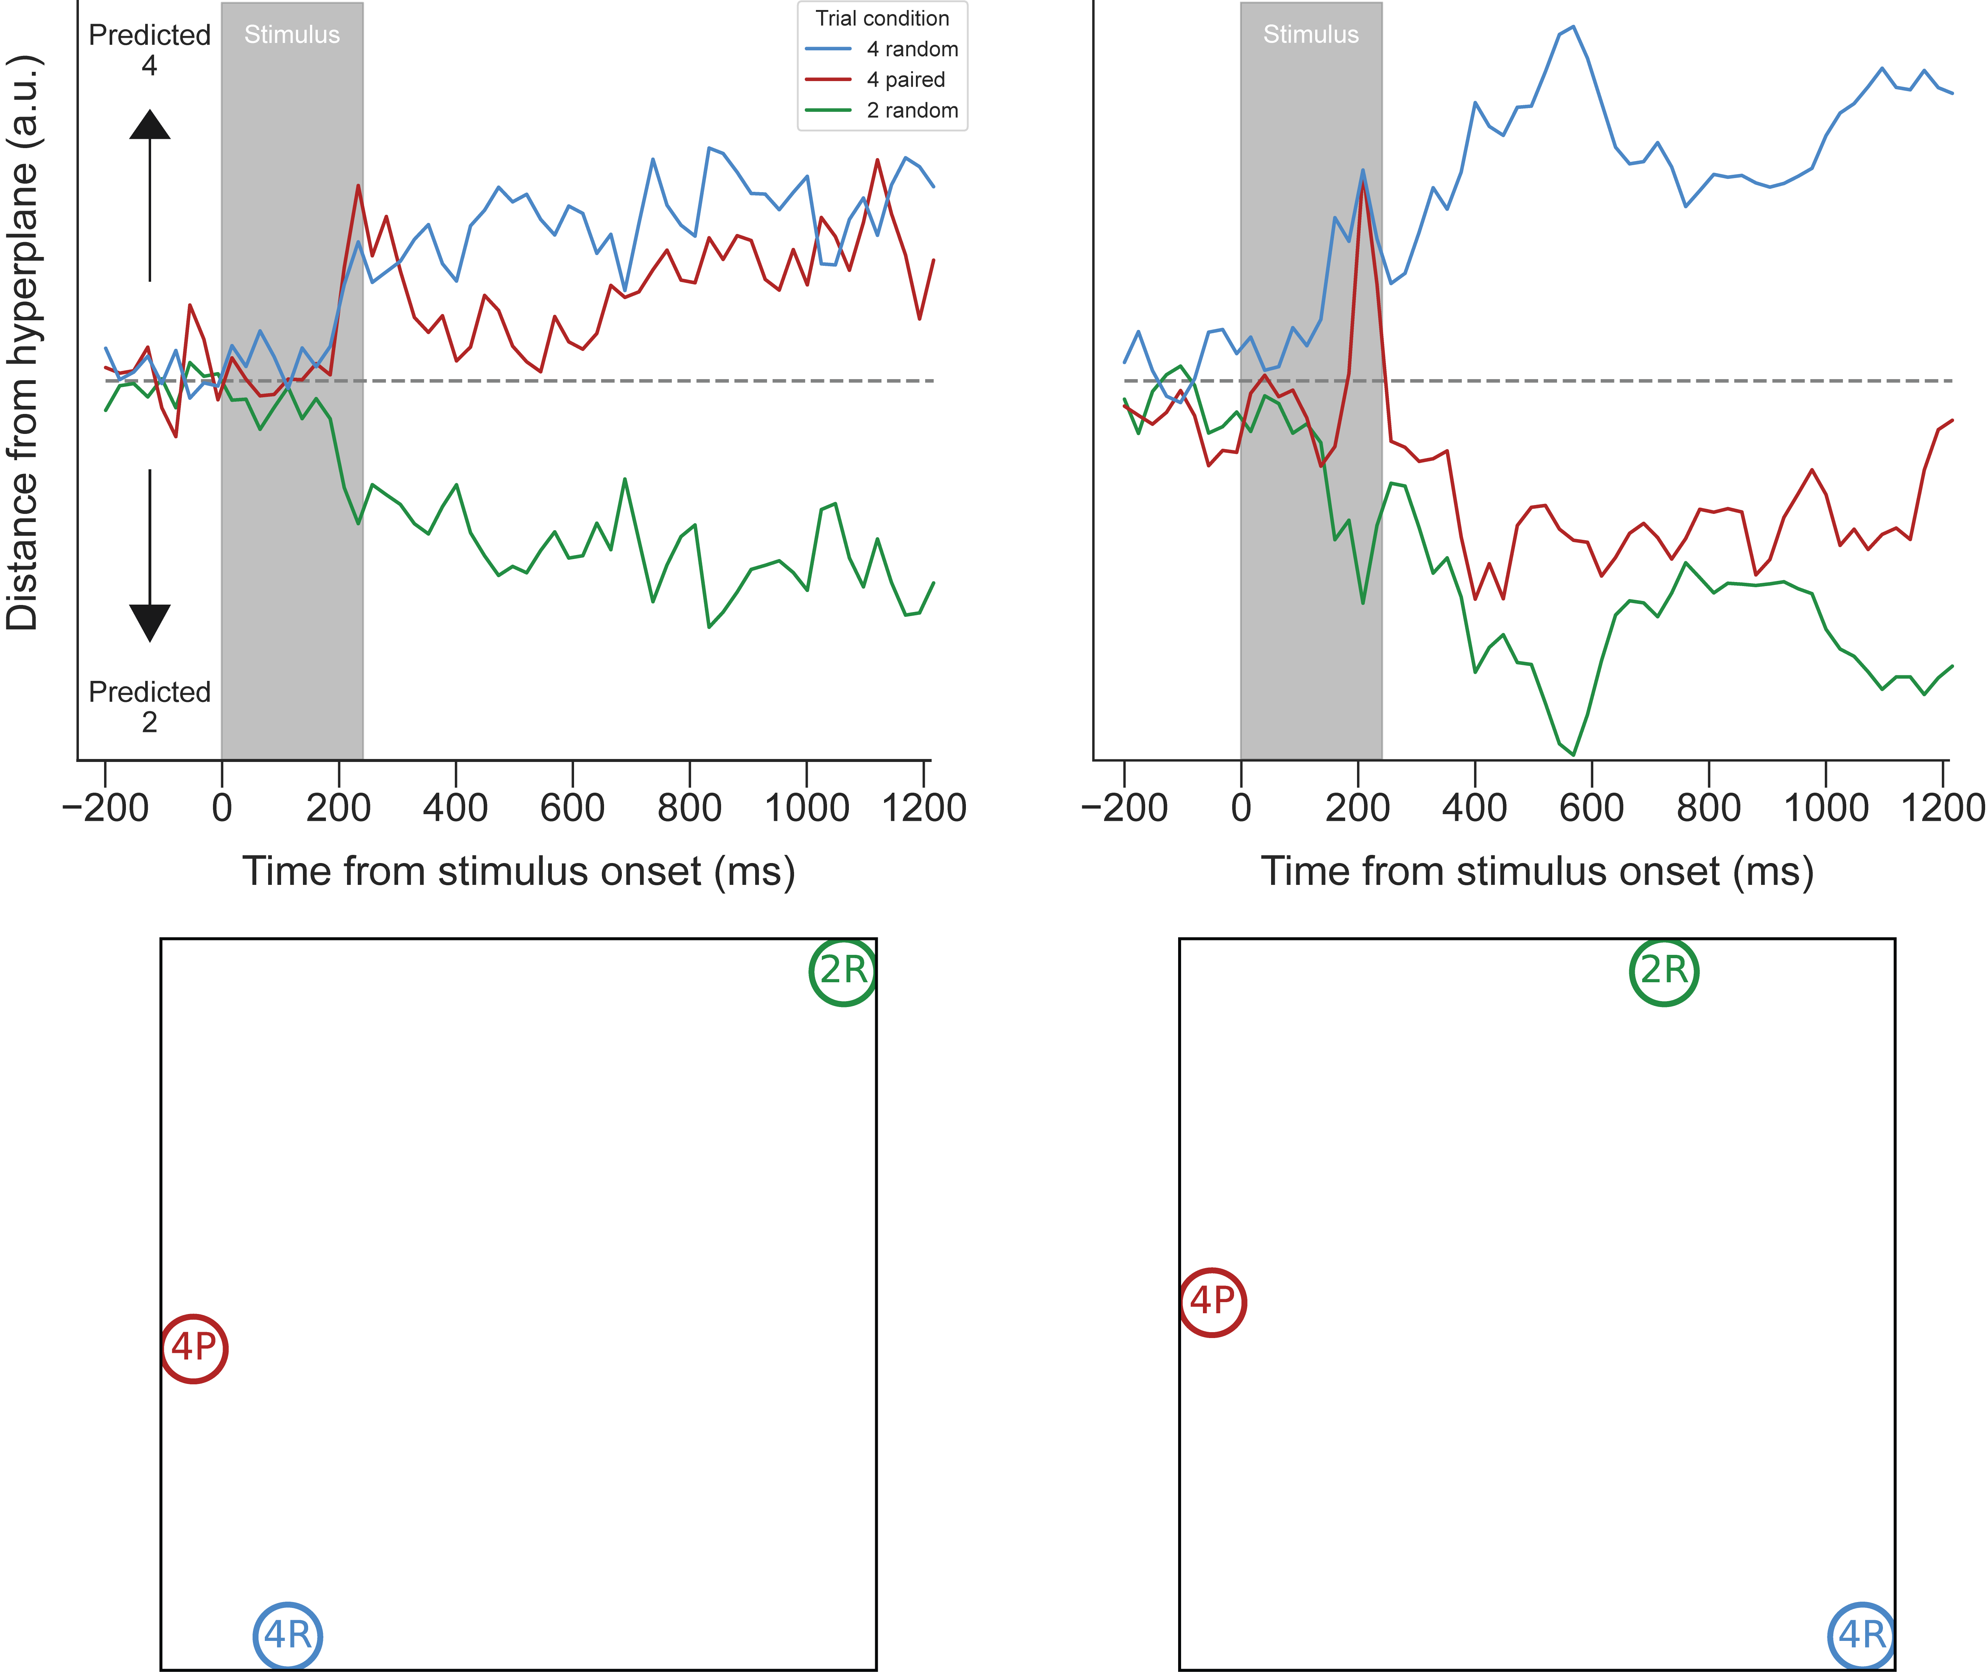
Individual differences
2R
“Weak chunking”
4P
4R
2R
“Strong chunking”
4P
4R

Slide 31
Individual differences
4P
“Weak chunking”
4R
2R
“Strong chunking”
4P
4R
2R

Slide 32
Individual differences
4R
“Weak chunking”
4P
2R
4R
“Strong chunking”
4P
2R

Slide 33
Individual differences
“Weak chunking”
4R
4R
4P
“Strong chunking”
4P
2R
2R

Slide 34
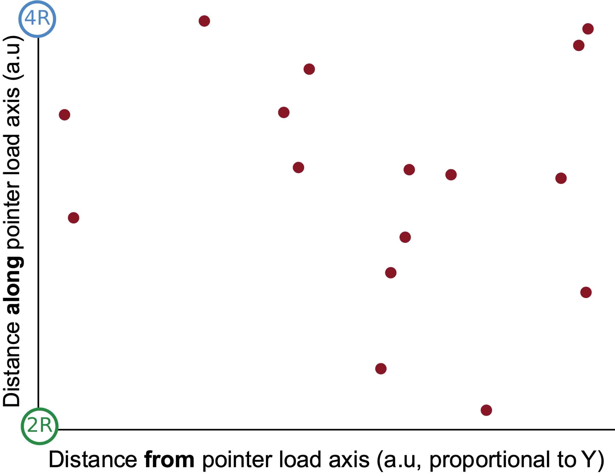
Individual differences
Potential trajectory
of learning

Slide 35
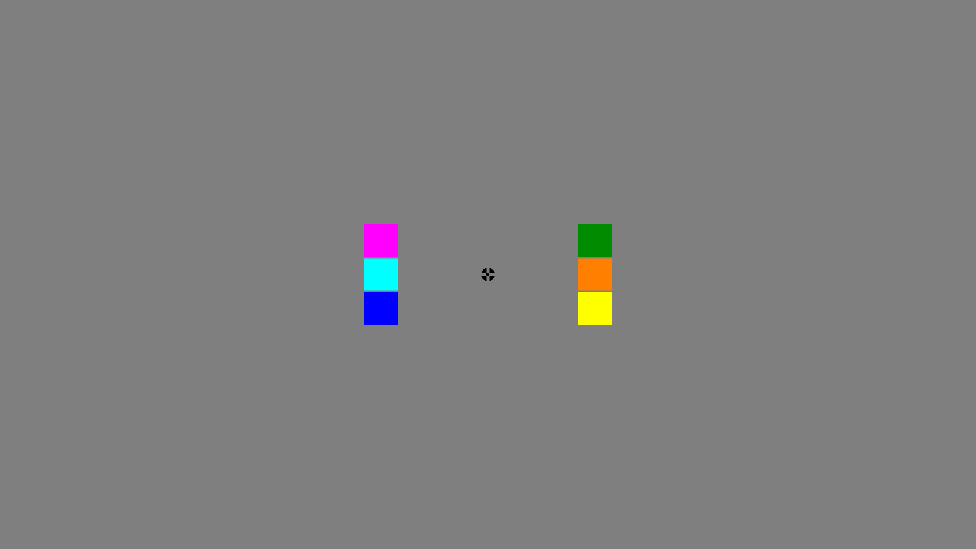
Experiment 2 - Training
Trained subjects to learn three color triplets

Slide 36
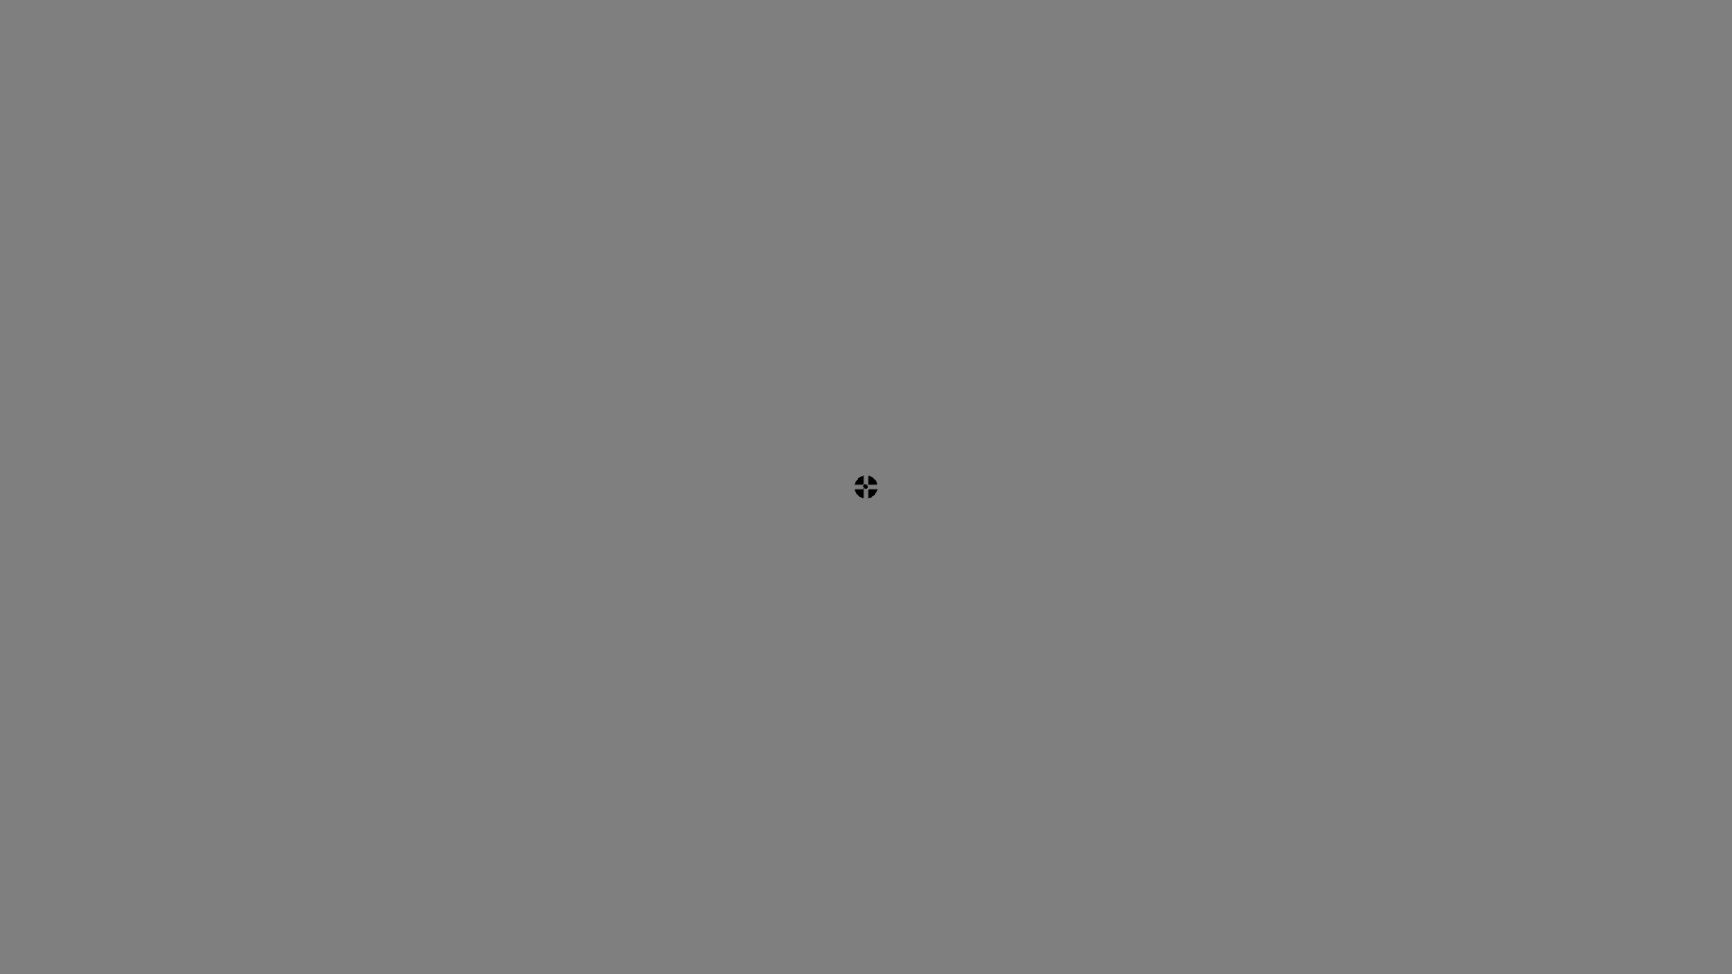
Experiment 2 - Training

Slide 37
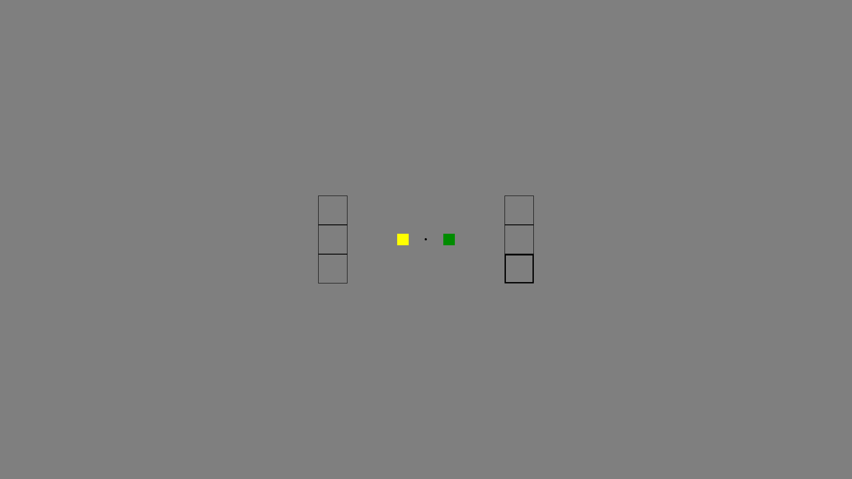
Experiment 2 - Training

Slide 38
Awareness Test

Slide 39
Awareness Test
Only subjects who correctly produced all triplets were considered “learners”

Slide 40
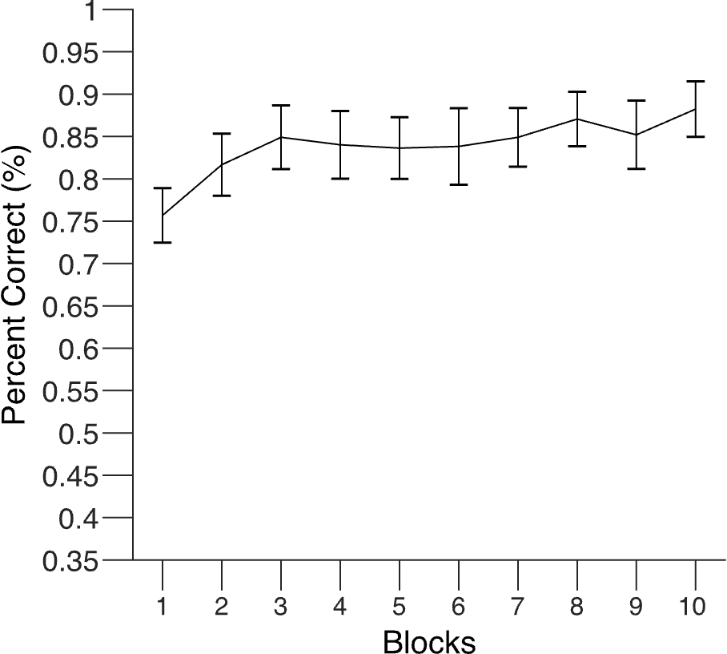
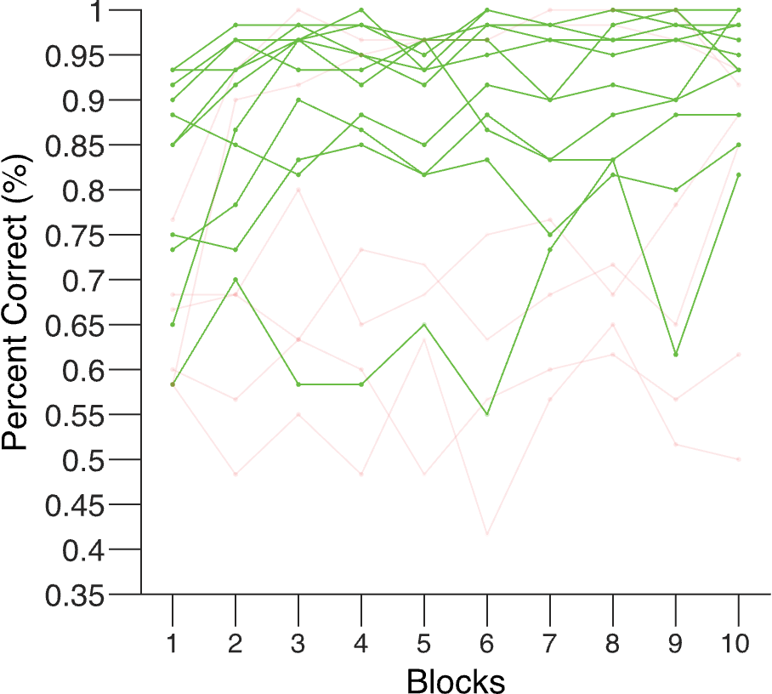
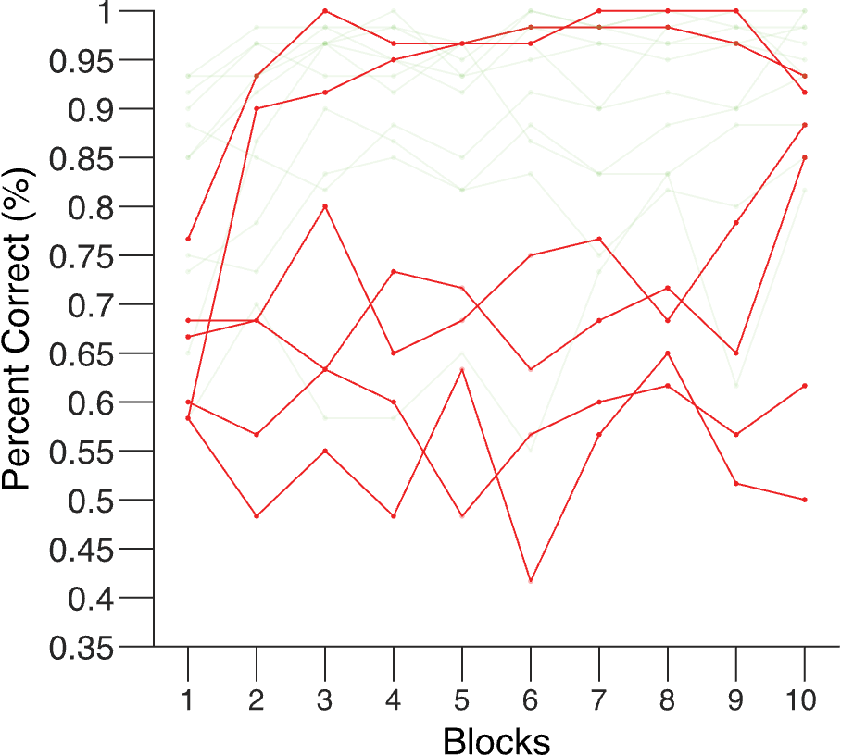
Experiment 2 Training
Aggregate
Learners
Non-learners

Slide 41
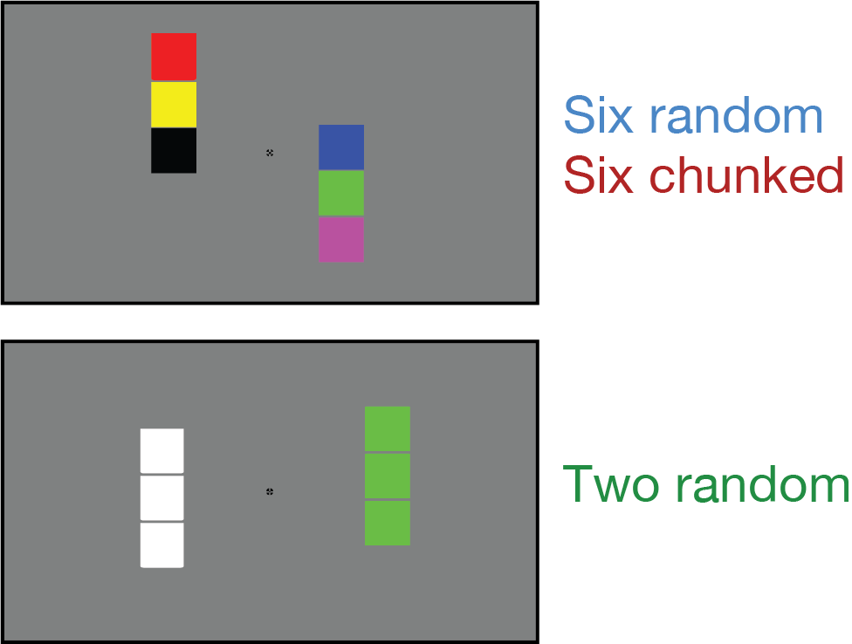
Experiment 2: EEG session
Perceptually
equivalent

Slide 42
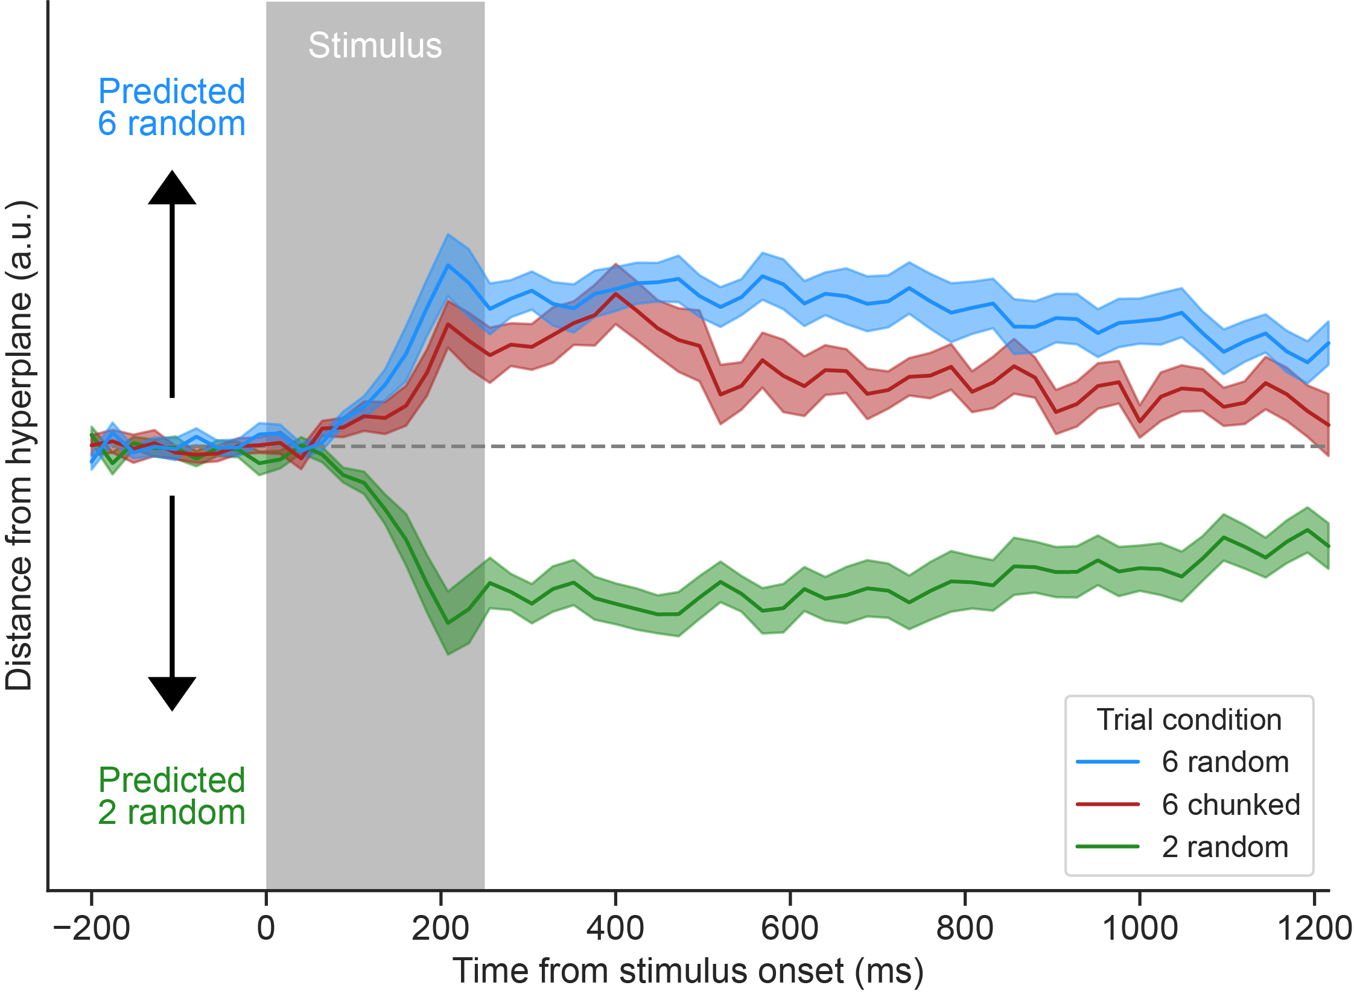
Train 6 random versus 2 random, test 6 chunked

Slide 43
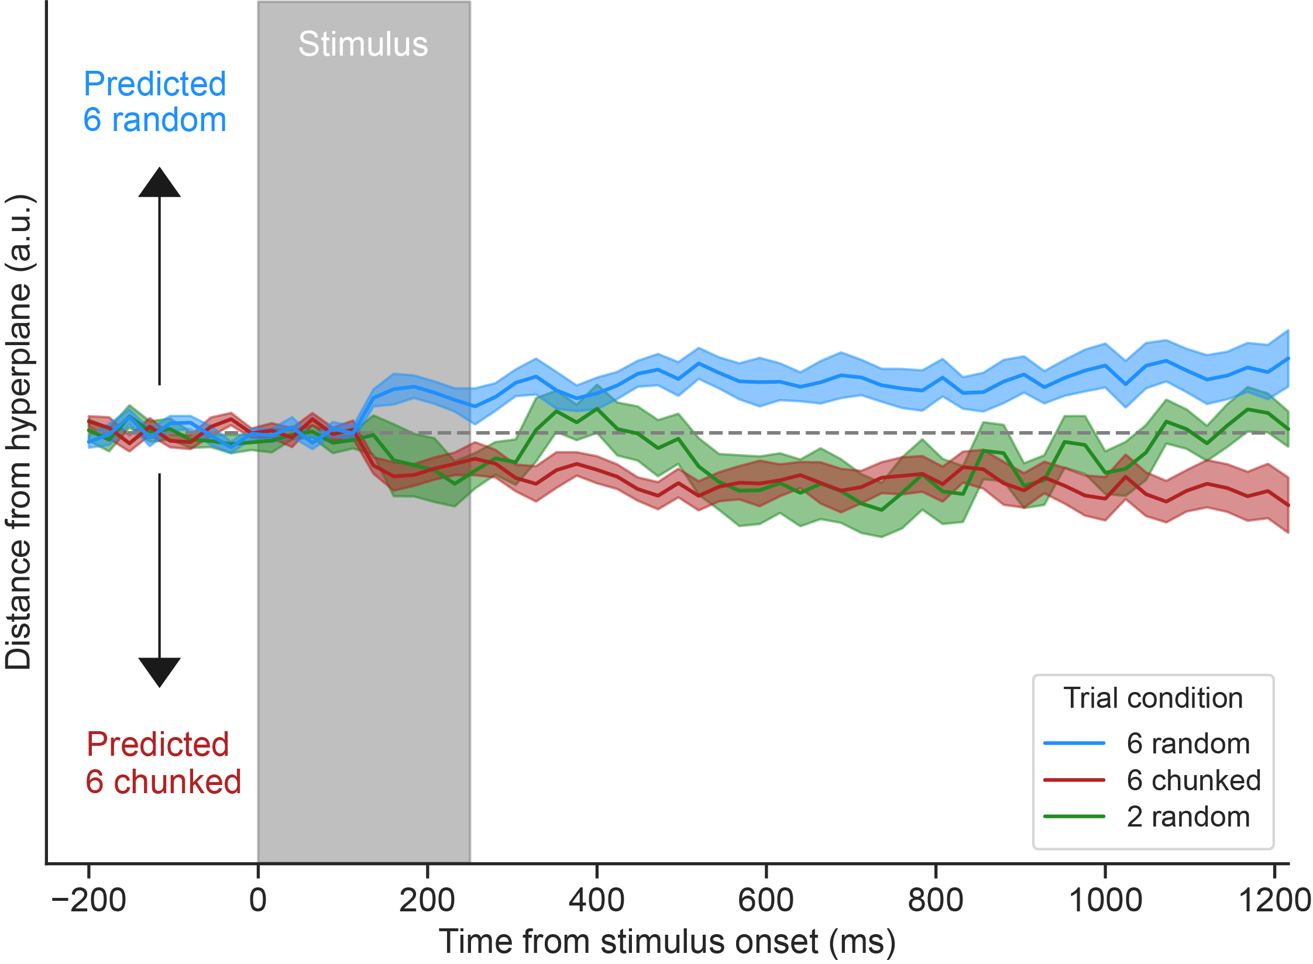
Train 6 random versus 6 chunked, test 2 random
Perceptually
equivalent

Slide 44
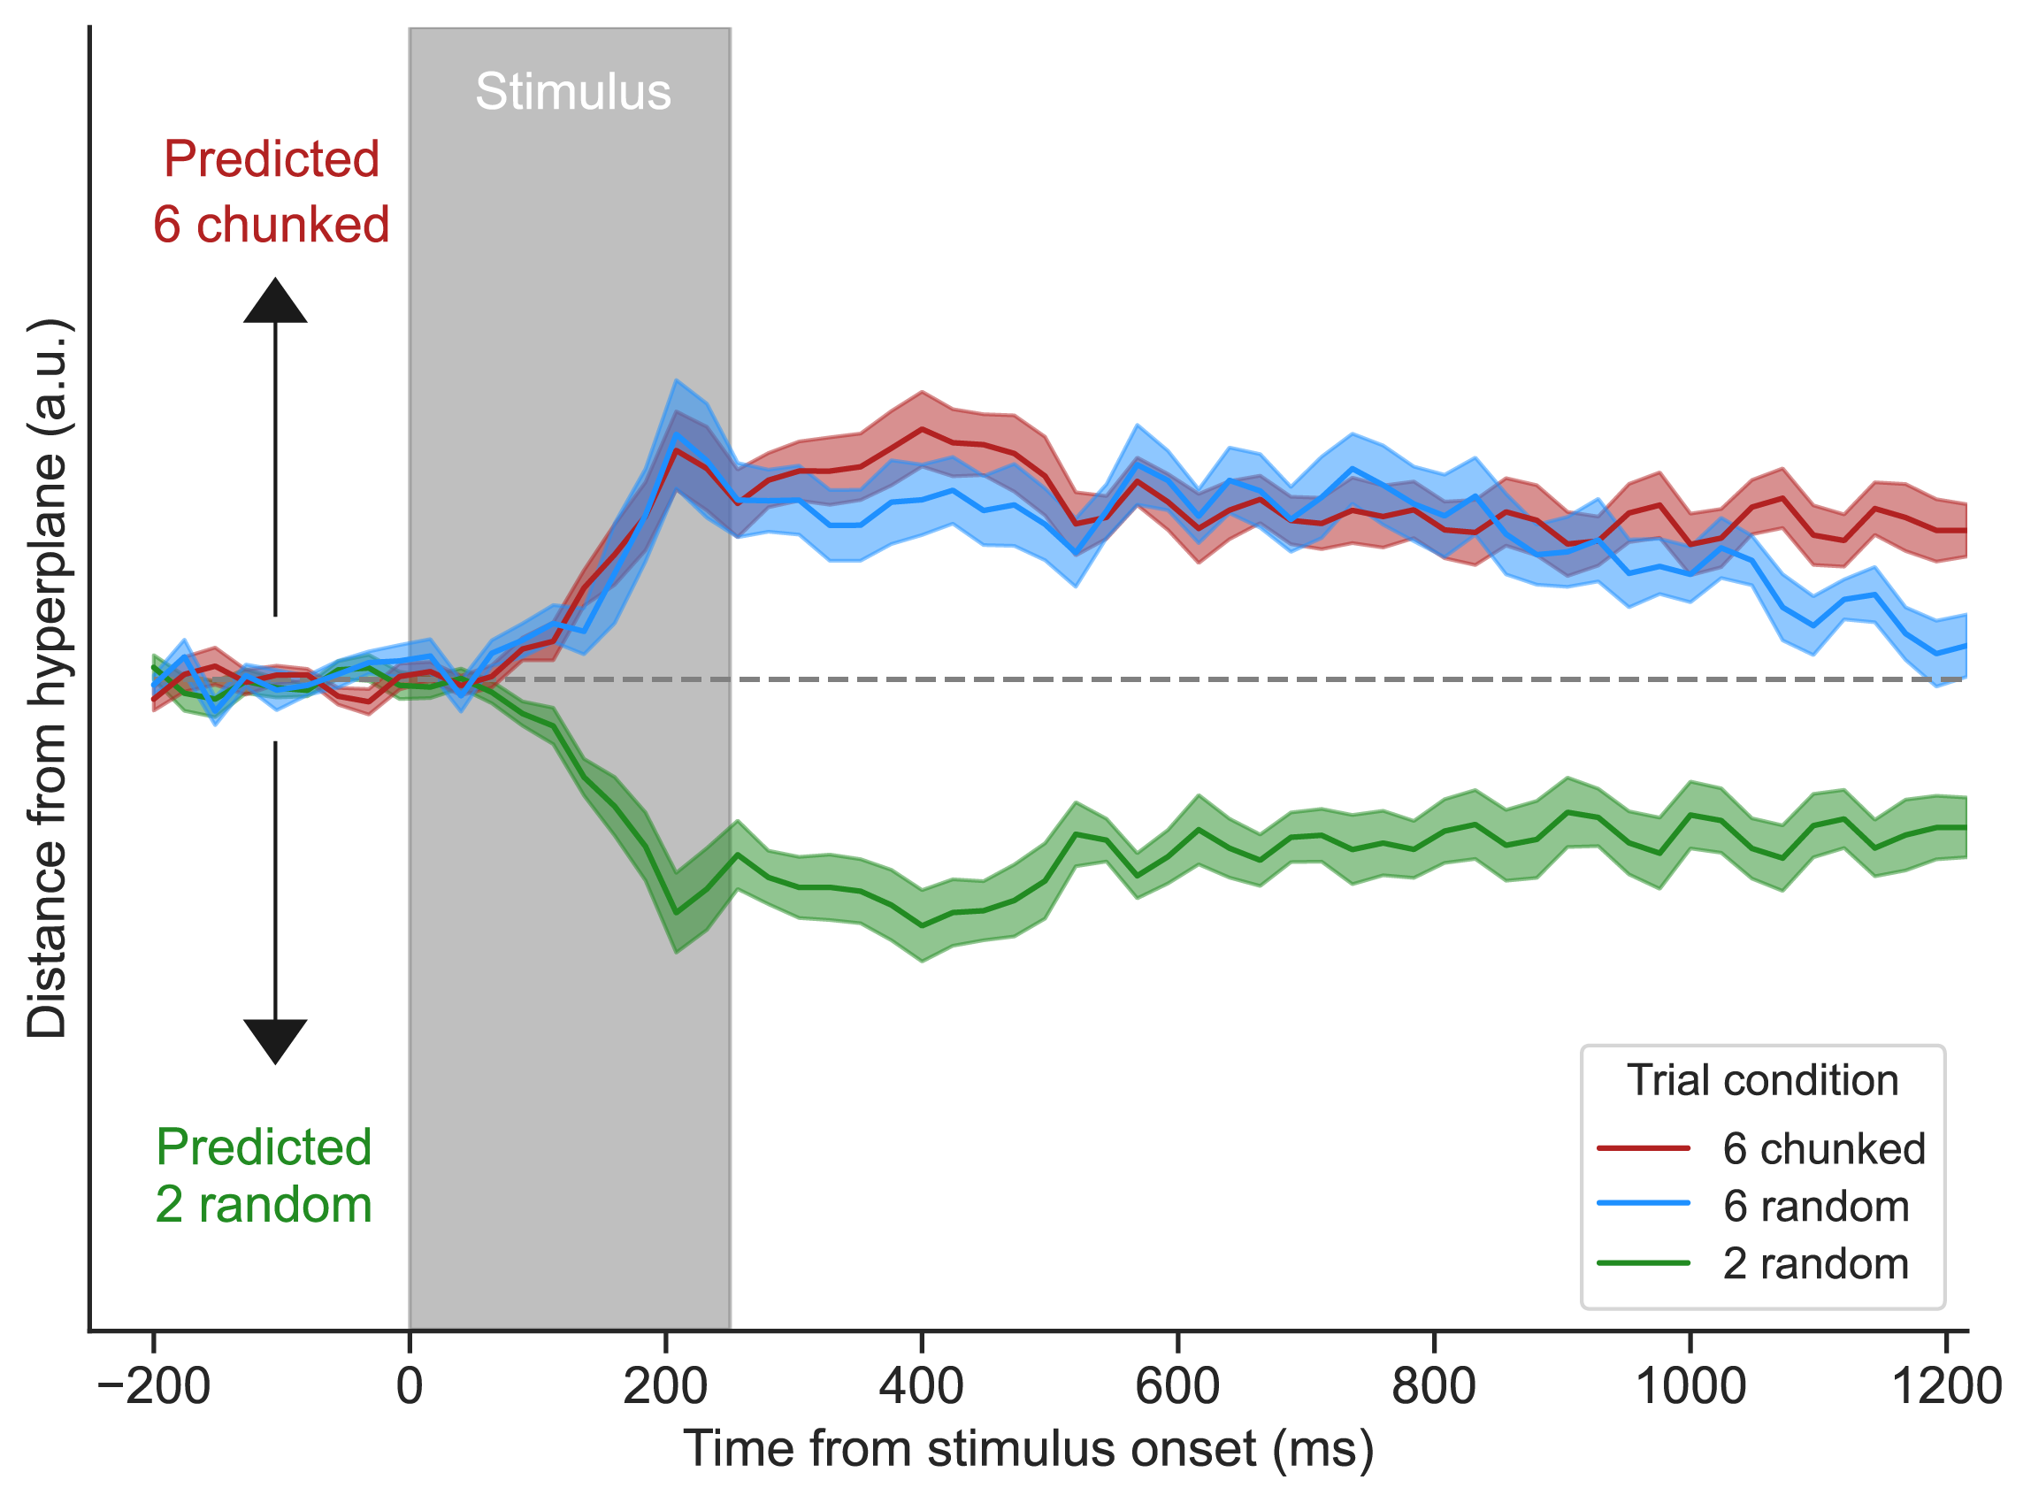
Train 2 random versus 6 chunked, test 6 random

Slide 45
Train 6 random versus 2 random, test 6 chunked
Multidimensional scaling
6R
6C
2R

Slide 46
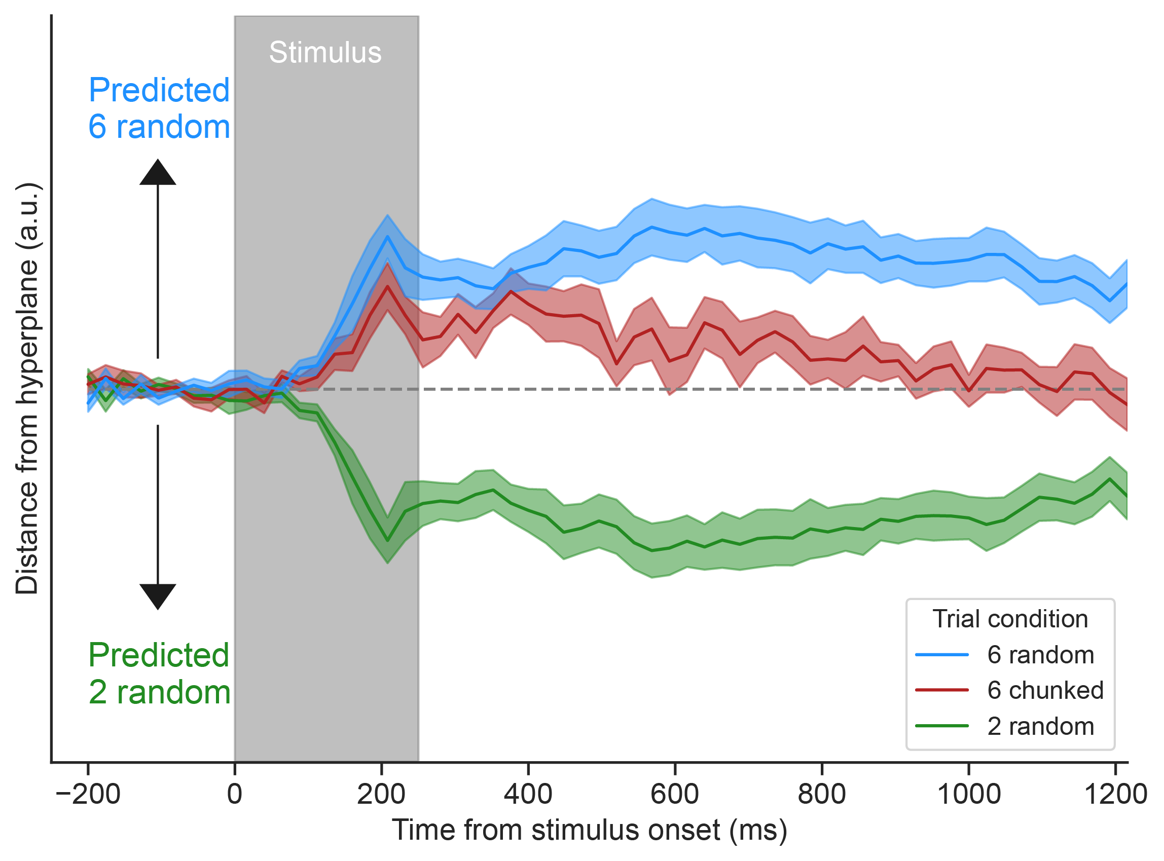
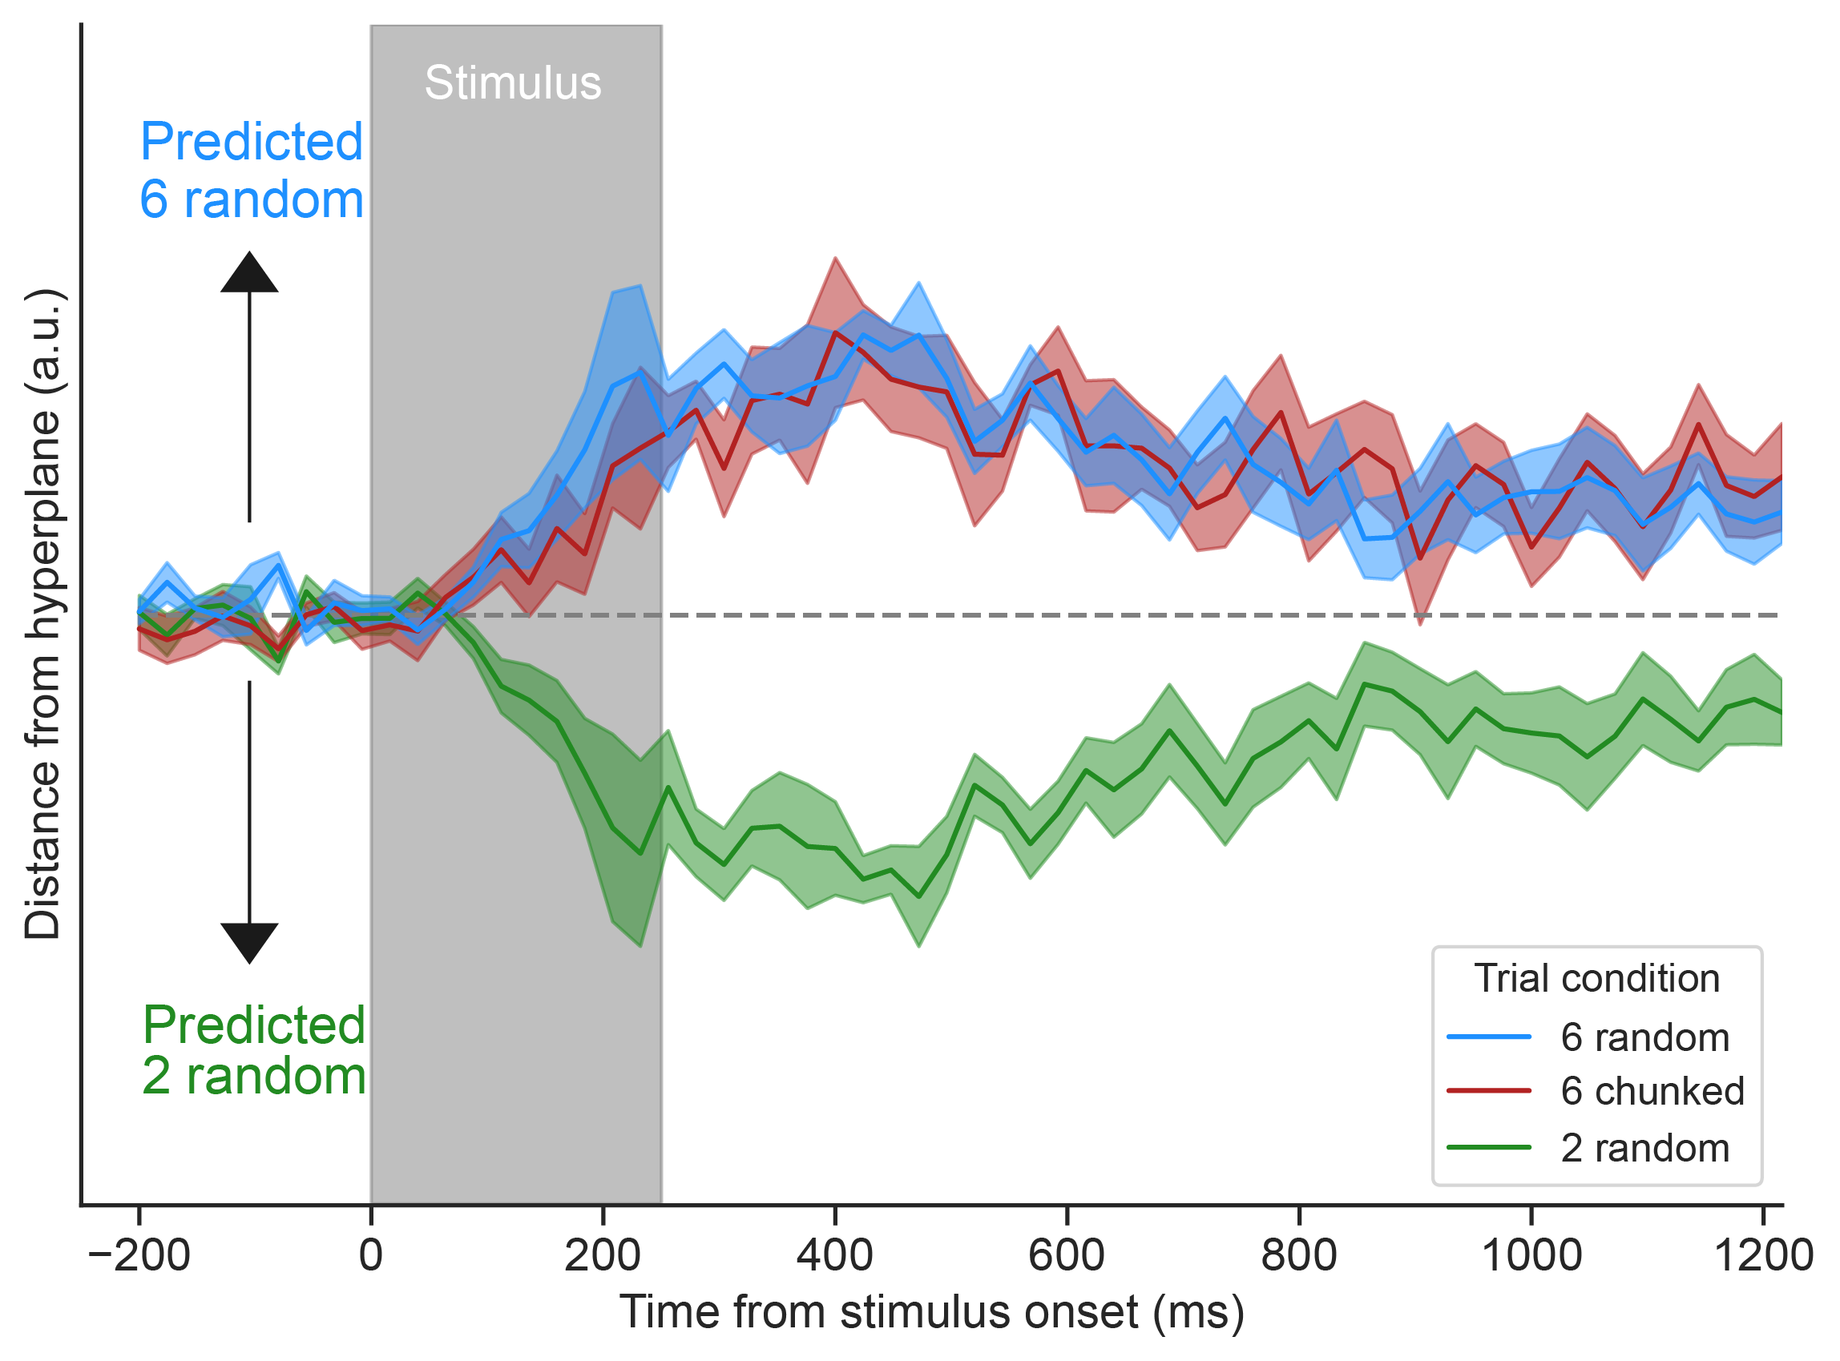
Learners vs non-learners
Learners (n = 12)
Non-learners (n = 6)

Slide 47
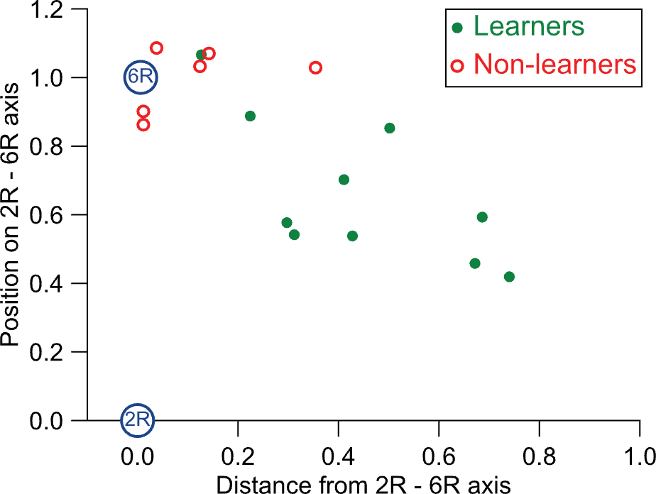
Multidimensional scaling on each subject
Potential trajectory of learning

Slide 48
Multidimensional scaling on each subject
Working memory load axis
Potential trajectory of learning
Long-term memory axis?

Slide 49
Conclusions
We asked whether associative learning:
Increases the number of representations in working memory (memory compression)
Or reduces the number of items stored in working memory (chunking)
A multivariate neural signal for items in working memory shows associative learning reduces the number of items stored in working memory
Furthermore, neural signatures of associative learning showed the reduction only in those that successfully learnt the associations
This is consistent with a chunking account – associative learning may not allow one to circumvent item limits

Slide 50







Will Epstein
Henry Jones
Darius Suplica
William Thyer
Edward Awh
Leo Chang
Scan for the Awh Vogel lab’s VSS content including this talk’s slides
Check out Leo’s related pre-data poster happening right now in Banyan
Follow me:
william.ngiam@adelaide.edu.au
@willngiam.bsky.social

Slide 51

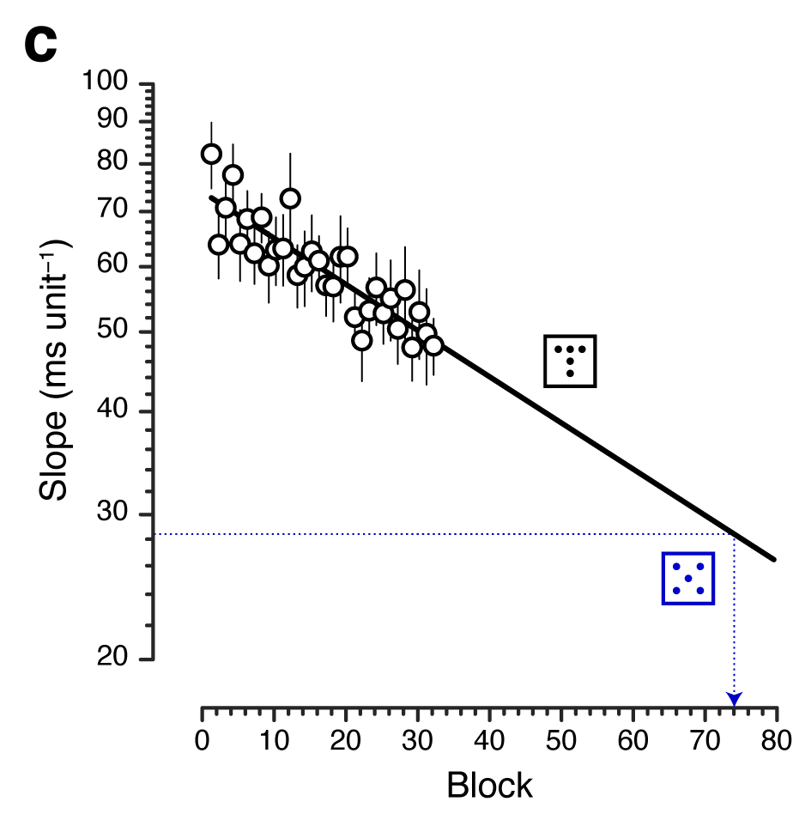
Why does the learned condition not cross the hyperplane?
Working memory pointer axis
Eventual in situ compression
in working memory?
Long-term memory axis
https://osf.io/preprints/psyarxiv/gh5ps

Slide 52
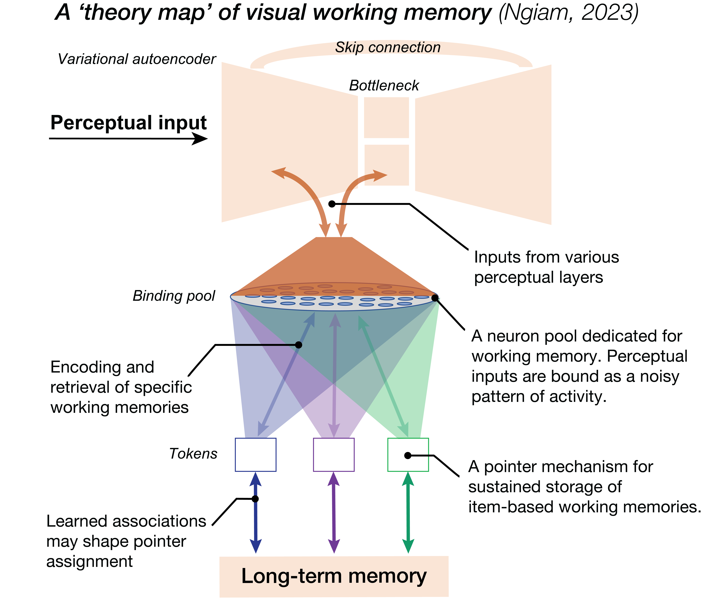
What are working memory pointers?

